Slide 1

Genetec CCTV End-User Training
Video Export Overview
Presented by:

Slide 2
Table of Contents
Genetec CCTV End-User Training
Video Export Overview
What are the different file formats available for exporting? Slide 3
How do I export video? Slide 4
What are the steps to export video from the Report Pane? Slides 5 - 8
What are the steps to export video from the Canvas? Slides 9 - 10
What are the steps to export video from the Dashboard? Slides 11 - 12
How do I share an exported video file? Slides 13 - 14
How will the recipient view the video? Slides 15 - 16
Additional Resources Slide 17
July 2019 / 5.7 version / 2

Slide 3
What are the different file formats available for exporting?
  You will be prompted to choose a file format for your exported video.
  G64x and G64 = preferred file format as they will maintain all supporting information of original video such as date and time stamp, bookmarks, original resolution, etc. and allows for re-exporting by recipient
  ASF and MP4 = common file formats that are viewable by common media players such as Windows Media Player. But will not maintain all supporting information of the original video.
  G64x and G64 require Security Desk or the Genetec Video Player to be able to view video but the Genetec Video Player can be packaged with the exported video file.
July 2019 / 5.7 version / 3

Slide 4
How do I export video?
You can export video in one of three ways:
From the Report Pane, by clicking on the “Export video” icon.
From the Canvas, by right-clicking on a tile.
From the Dashboard, by clicking on the “Export video” icon.
The following pages display screenshots and identify the specific steps involved in each option above.
July 2019 / 5.7 version / 4

Slide 5
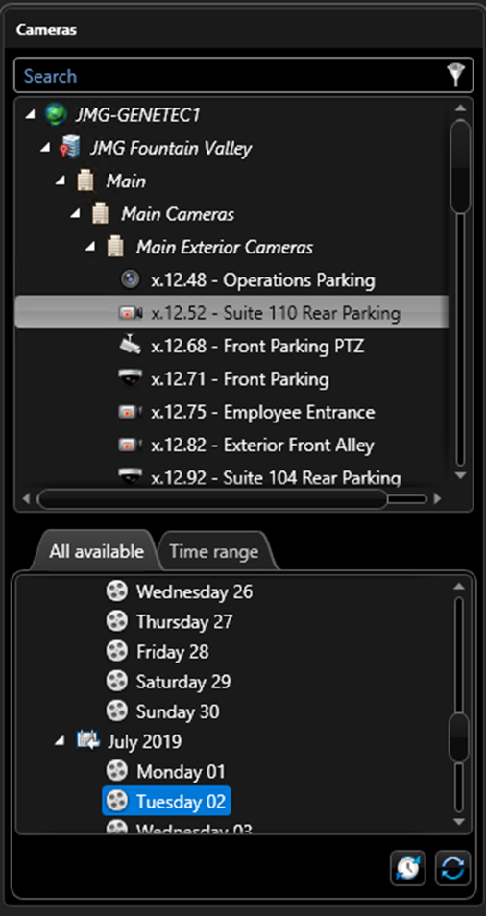

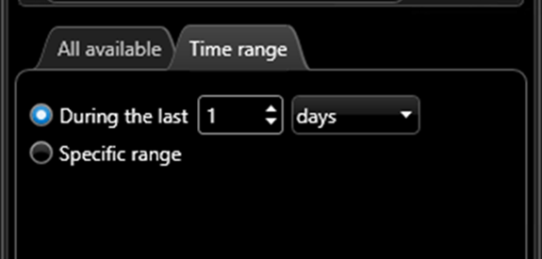
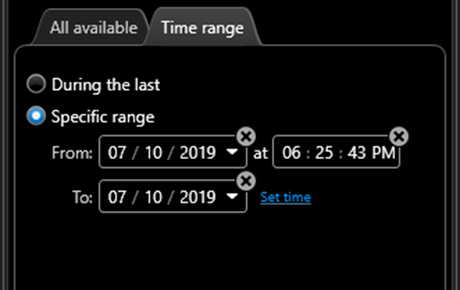
What are the steps to export video from the Report Pane?
From the Archives task, select a camera
Select a time period by either
  Choosing the tab “All Available” and selecting one of the days displayed
  OR
  Choosing the tab “Time range” and manually specifying the time period
July 2019 / 5.7 version / 5

Slide 6
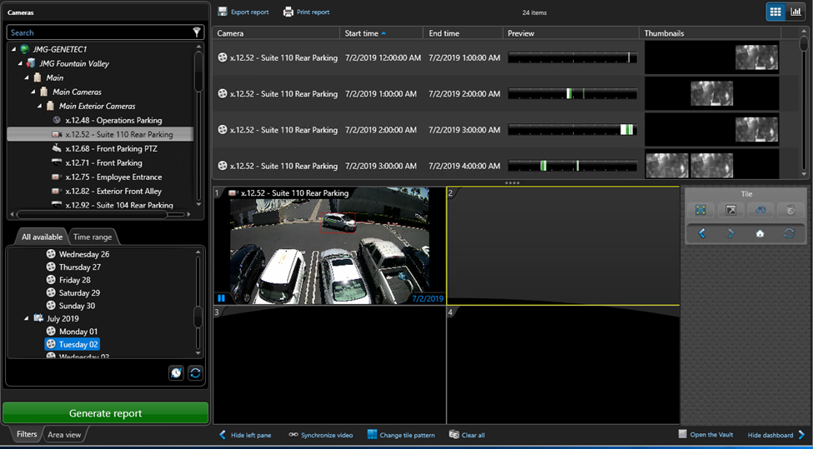

What are the steps to export video from the Report Pane?
Click the “Generate report” green button at the bottom.
The report results will display all available video in one-hour increments.
For easier viewing of report results, drag the “….” down to shrink the canvas.
July 2019 / 5.7 version / 6

Slide 7
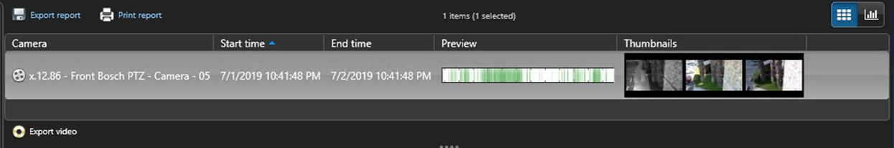

What are the steps to export video from the Report Pane?
Select the desired line item(s) from the report results.
Click on the “Export video” icon in the lower left corner of the report results.
July 2019 / 5.7 version / 7

Slide 8
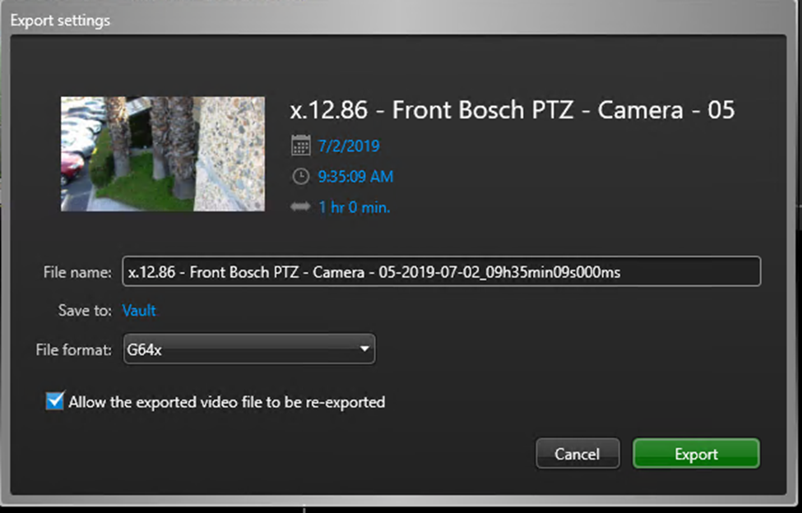
What are the steps to export video from the Report Pane?
Confirm date, time, duration, file name and file format in the pop-up window. To change any of the parameters simply click on the blue text.
Click the green “Export” button to start the export process.
Upon completion of the export process, the file will be saved in the Security Desk Vault.
July 2019 / 5.7 version / 8

Slide 9
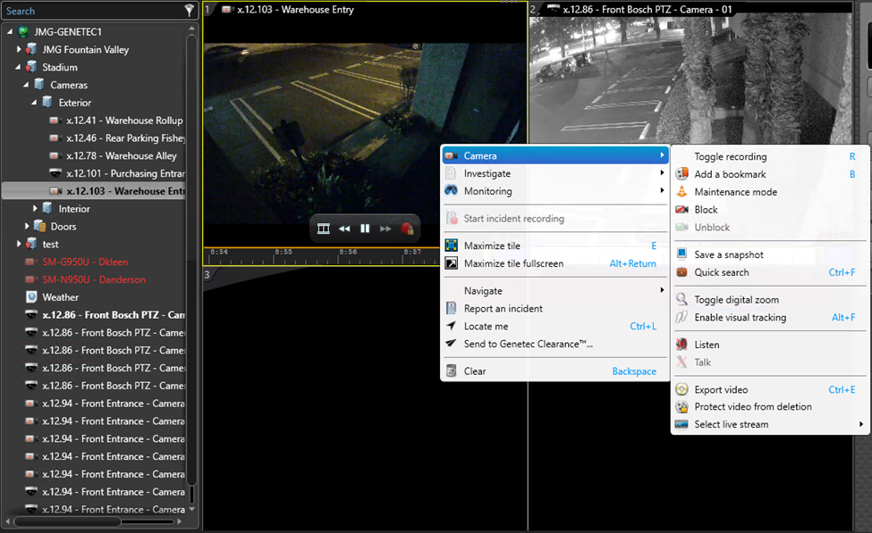
What are the steps to export video from the Canvas?
Select the tile with the video stream you wish to export and right click. Look for the yellow border around the tile to confirm selection.
Select “Camera”
Select “Export Video”
July 2019 / 5.7 version / 9

Slide 10
What are the steps to export video from the Canvas?
Confirm date, time, duration, file name and file format in the pop-up window. To change any of the parameters simply click on the blue text.
Click the green “Export” button to start the export process.
Upon completion of the export process, the file will be saved in the Security Desk Vault.
July 2019 / 5.7 version / 10

Slide 11
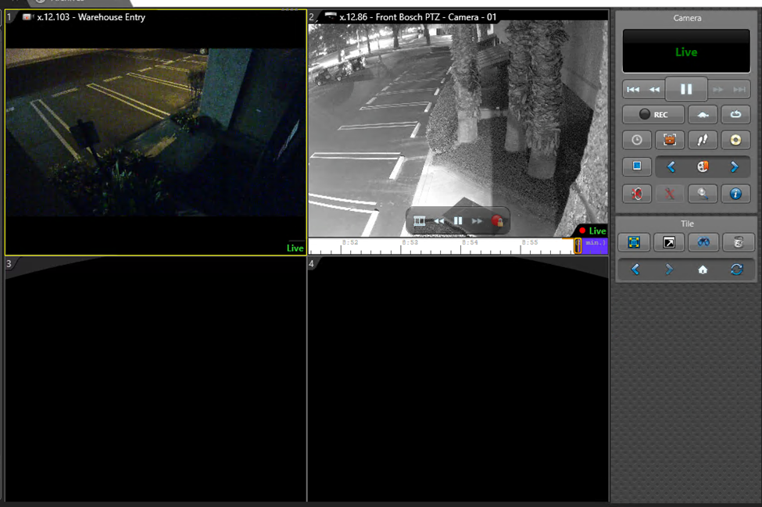
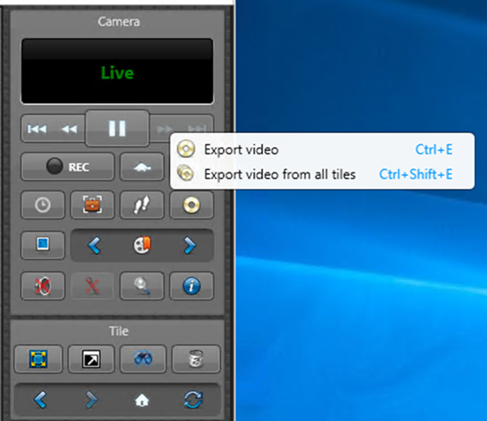
What are the steps to export video from the Dashboard?
Select the tile with the video stream you wish to export. Look for the yellow border around the tile to confirm selection.
Select the Export Video icon from the Dashboard.
Choose “Export video” to export highlighted tile or “Export video from all tiles”.
July 2019 / 5.7 version / 11

Slide 12
What are the steps to export video from the Dashboard?
Confirm date, time, duration, file name and file format in the pop-up window. To change any of the parameters simply click on the blue text.
Click the green “Export” button to start the export process.
Upon completion of the export process, the file will be saved in the Security Desk Vault.
July 2019 / 5.7 version / 12

Slide 13
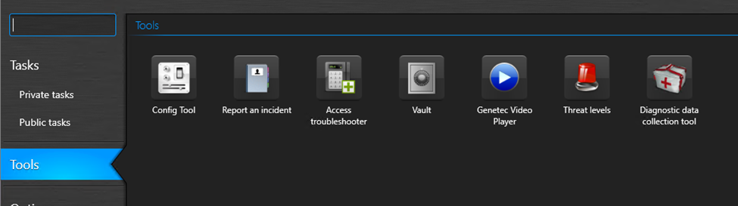
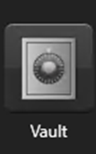
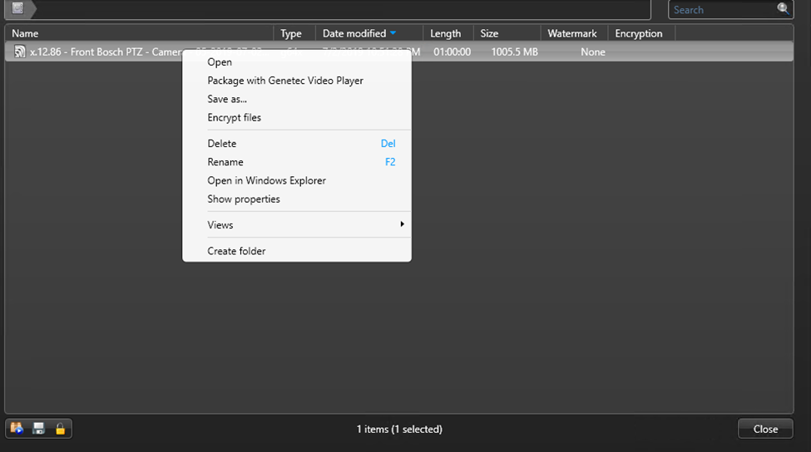
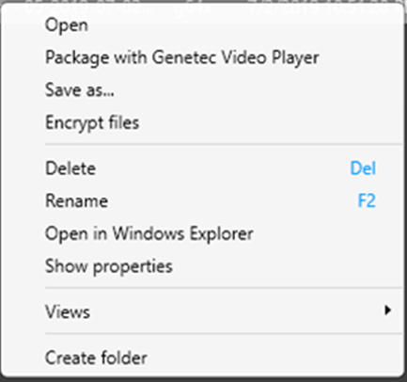
How do I share an exported video file?
  All exported video are stored in the Security Desk Vault. To access these files:
  Click on “Tools” from the left navigation bar on the Security Desk home page.
  Click on the “Vault” icon.
  The Vault screen will display all exported video files. Select the file you want to share.
  In the pop-up window, select “Package with Genetec Video Player” so that the recipient will be able to view the video without access to Genetec Security Desk.
July 2019 / 5.7 version / 13

Slide 14
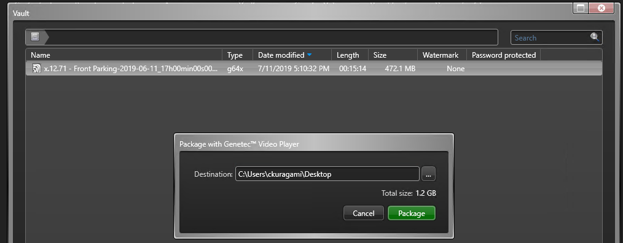
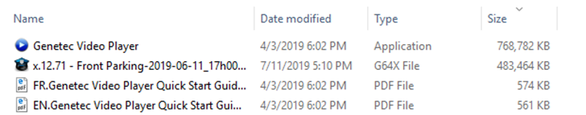
How do I share an exported video file?
  Choose the preferred destination on your computer and click “Package”.
  Navigate to that location on your computer and see the four files downloaded: Video Player, Video Clip, Video Player Guide in French and in English. Copy the files on to a thumb drive to share the video.
July 2019 / 5.7 version / 14

Slide 15
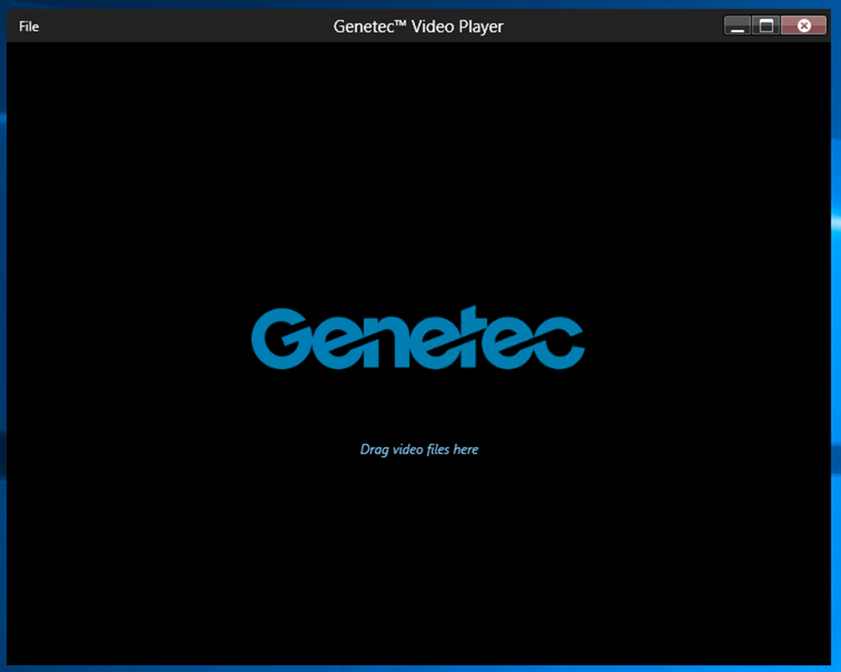
How will the recipient view the video?
  Once the recipient launches the Genetec video player, he/she will see this screen.
  Upon dragging the video file into the center of the player, the video will start playing.
July 2019 / 5.7 version / 15

Slide 16
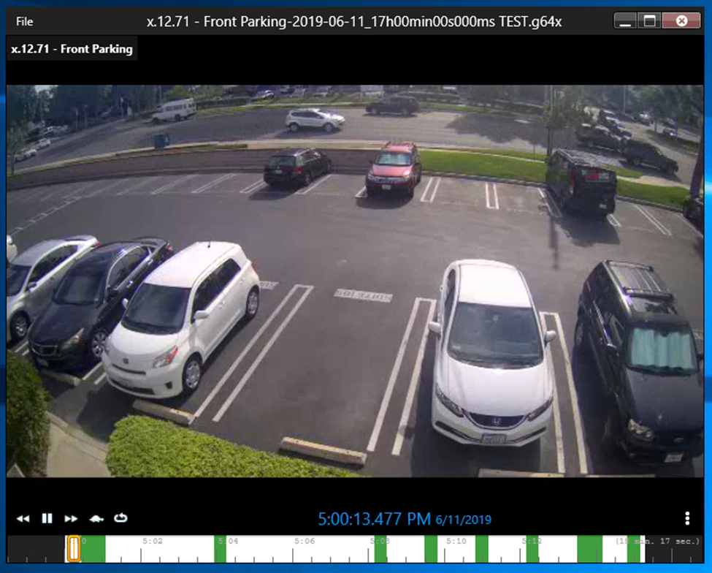
How will the recipient view the video?
  The user interface for viewing video in the stand-alone player will look much like the Security Desk application with a prominent time stamp and ability to rewind, pause and fast forward.
July 2019 / 5.7 version / 16

Slide 17
Additional Resources
For additional resources on how to get the most out of your security system, please visit our website at:
www.jmgsecurity.com
Additional PowerPoint training guides are available from JMG on topics such as overview of Security Desk, viewing live video and searching recorded video. To request any of these, please contact JMG at 800-900-4564.
July 2019 / 5.7 version / 17

