Slide 1

Genetec CCTV End-User Training
Searching Video Overview
Presented by:

Slide 2
Table of Contents
Genetec CCTV End-User Training
Searching Video Overview
What are the ways I can search past video? Slide 3
How do I search past video by date/time and camera(s)? Slides 4 - 7
How do I search past video for motion? Slides 8 - 11
How do I search past video for a specific area? Slides 12 - 16
How do I search past video for bookmarks? Slides 17 – 18
Additional Resources Slide 19
July 2019 / 5.7 version / 2

Slide 3

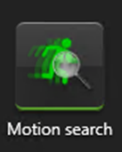
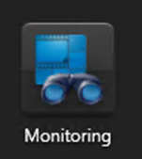

What are the ways I can search past video?
  The most commonly-used search parameters and the associated Security Desk task for each parameter are shown below:
    Date and time
    Camera(s)
    Motion
  Targeted area
  Bookmarks
July 2019 / 5.7 version / 3

Slide 4
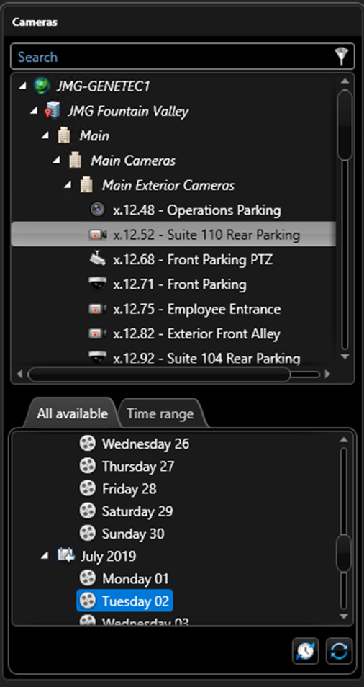
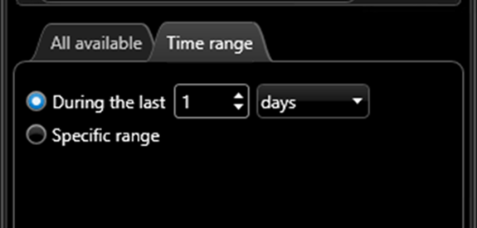
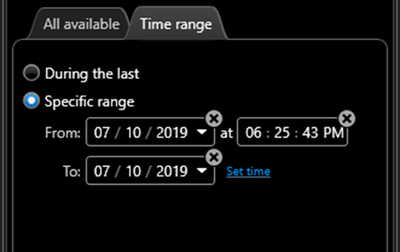
How do I search past video by date/time and camera(s)?
From the Archives task, select a camera
Select a time period by either
  Choosing the tab “All Available” and selecting one of the days displayed
  OR
  Choosing the tab “Time range” and manually specifying the time period
July 2019 / 5.7 version / 4

Slide 5
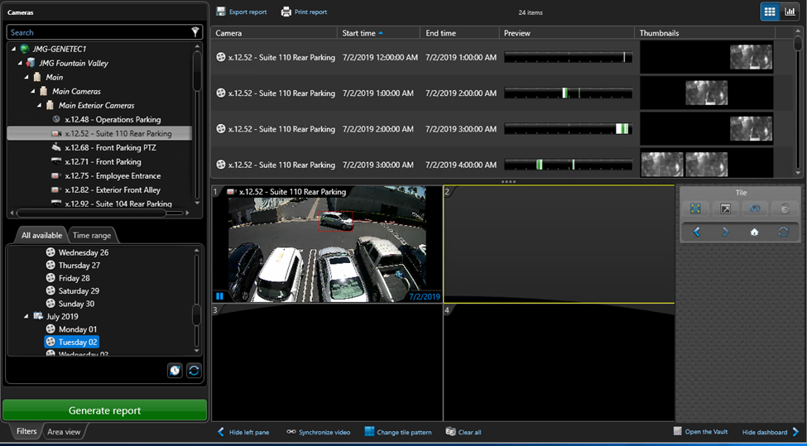
How do I search past video by date/time and camera(s)?
Click the “Generate report” green button at the bottom.
The report results will display all available video in one-hour increments.
For easier viewing of report results, drag the “….” down to shrink the canvas.
July 2019 / 5.7 version / 5

Slide 6
How do I search past video by date/time and camera(s)?
To view any of the report results simply drag it into one of the canvas tiles.
July 2019 / 5.7 version / 6

Slide 7
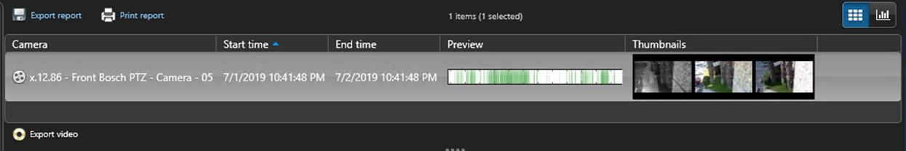

How do I search past video by date/time and camera(s)?
If you’d like to export any of the video sequences, simply select the desired line item(s) from the report results and click on the “Export video” icon in the lower left corner of the report results.
July 2019 / 5.7 version / 7

Slide 8
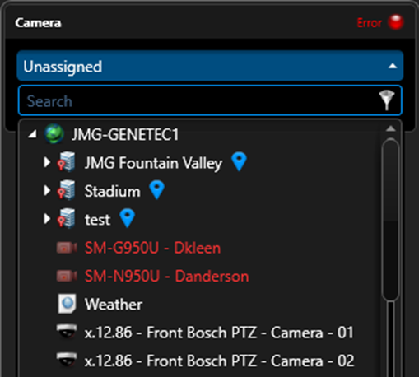
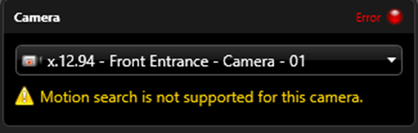
How do I search past video for motion?
From the Motion Search task, select camera(s) by opening the camera drop down menu at the top of the screen.
If the camera you selected does not support motion search functionality you will receive the following message.
July 2019 / 5.7 version / 8

Slide 9
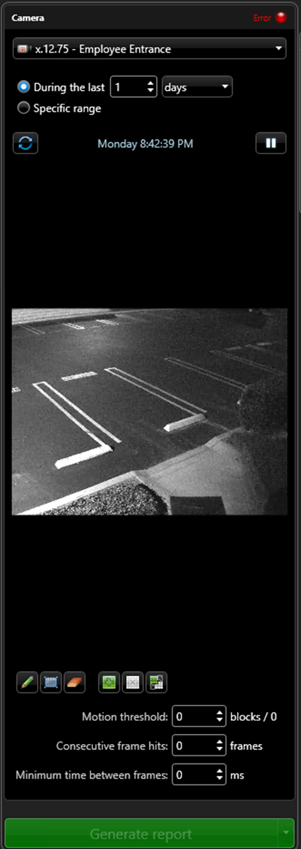
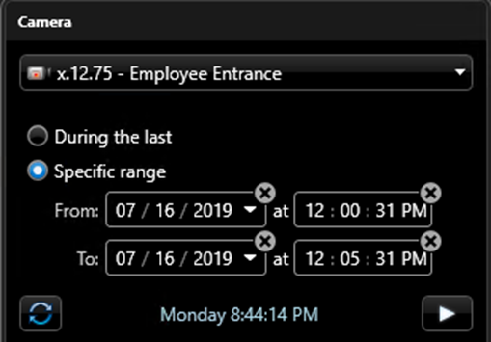
How do I search past video for motion?
Select a time range for your search by either specifying how many days or which dates/times you would like to search.
OR
July 2019 / 5.7 version / 9

Slide 10


How do I search past video for motion?
Use the icons below the preview image to define the motion detection zone
Fill tool: Defines the motion detection zone as the entire image
Rectangle tool: Allows you to draw a rectangle to determine motion detection zone.
Eraser tool: Allows you to erases specific previously drawn motion detection zones.
Clear All tool: Clears all previously drawn motion detection zones.
July 2019 / 5.7 version / 10

Slide 11
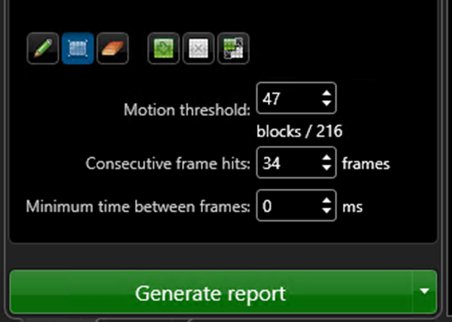
How do I search past video for motion?
You may influence the speed and accuracy of the motion detection search by altering the following parameters:
  Motion threshold: The higher the number the more motion required to appear in the report results.
  Consecutive frame hits: The higher the number the more frames that must contain motion to appear in the report results.
  Minimum time between frames: The higher the value, the more frames the system skips during the search process and the faster (but less accurate) the search process becomes. To examine every frame, set value to 33 ms or less.
Click on the green button at the bottom “Generate report”.
July 2019 / 5.7 version / 11

Slide 12
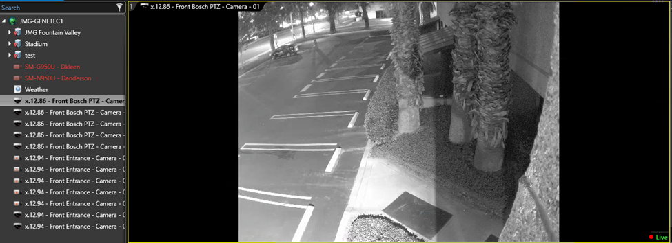
How do I search past video for a specific area?
If you know which camera recorded a specific event and a time when it might have taken place, you can search past video for the event.
From the Monitoring task, drag the desired camera into a tile on the canvas.
Make sure the tile is selected (indicated by a yellow border around the outside of the tile)
July 2019 / 5.7 version / 12

Slide 13
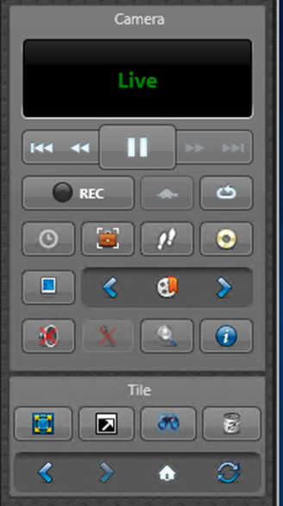
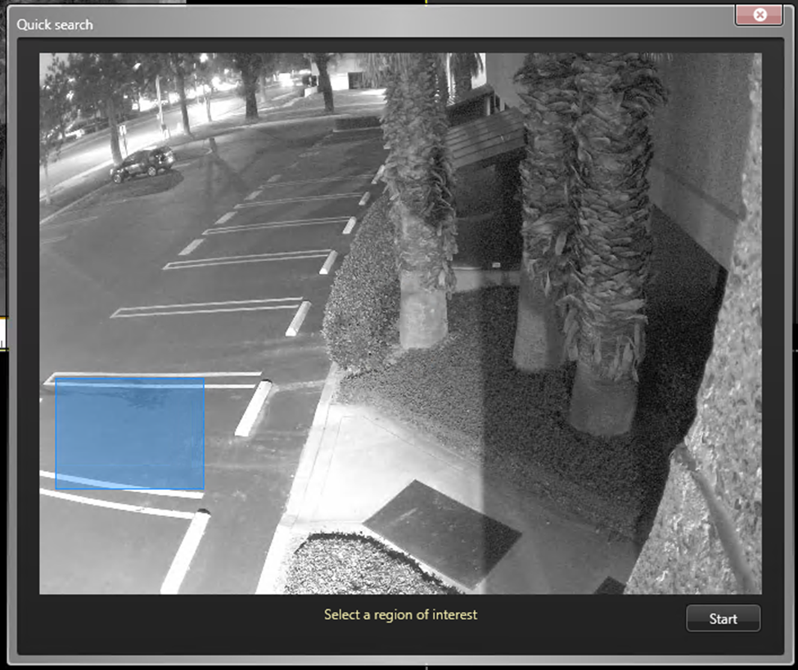
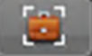
How do I search past video for a specific area?
Click on the “Quick search” icon on the dashboard.
In the Quick search pop up window, use your mouse to draw a rectangle around the area you want to search.
Click Start.
July 2019 / 5.7 version / 13

Slide 14
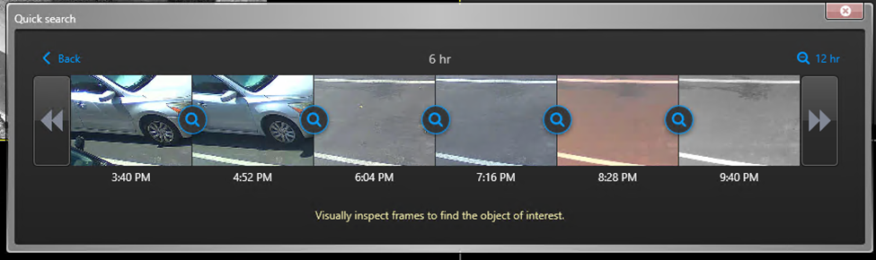
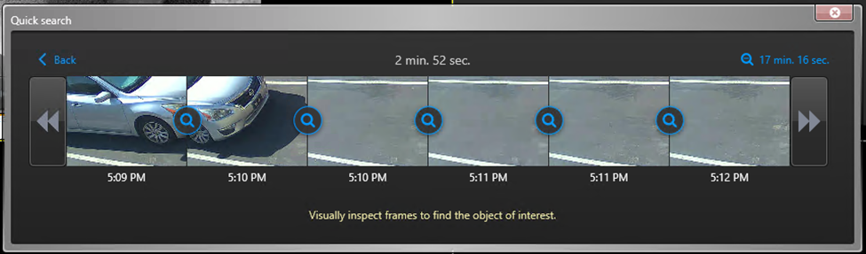
How do I search past video for a specific area?
An overview of the last six hours of video recording will be displayed in a series of thumbnails focused on just the area you selected.
To isolate what time this car left its parking spot, click several times on the magnifying glass icon to narrow down the time period.
Thanks to the Quick search feature we have determined the car left the parking spot at 5:10 PM.
July 2019 / 5.7 version / 14

Slide 15
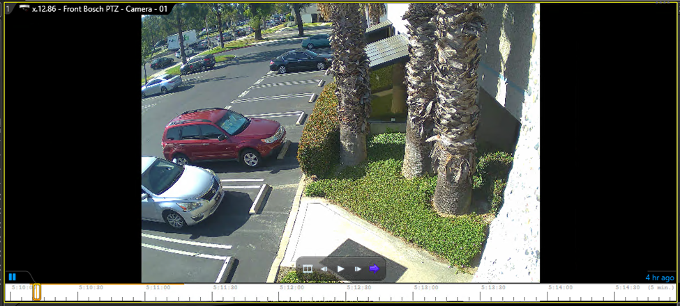
How do I search past video for a specific area?
To view the video associated with the car leaving its spot, simply click on the thumbnail and the corresponding video will being playing in the canvas.
July 2019 / 5.7 version / 15

Slide 16
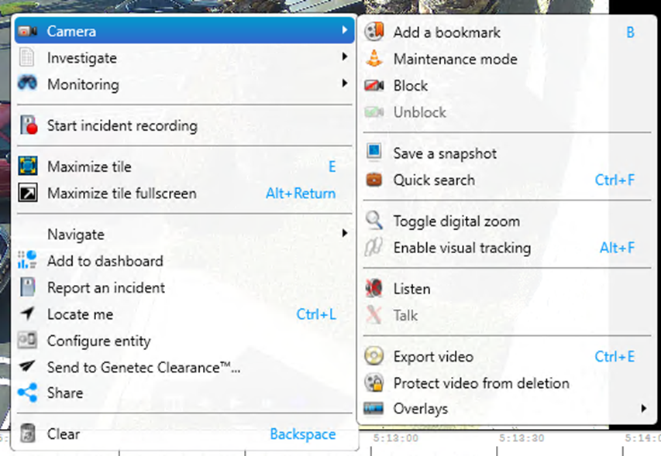
How do I search past video for a specific area?
Once a video is playing in the canvas, you can right click on the tile and click on “Camera” to access the following common options:
  Add a bookmark
  Save a snapshot
  Export video
July 2019 / 5.7 version / 16

Slide 17
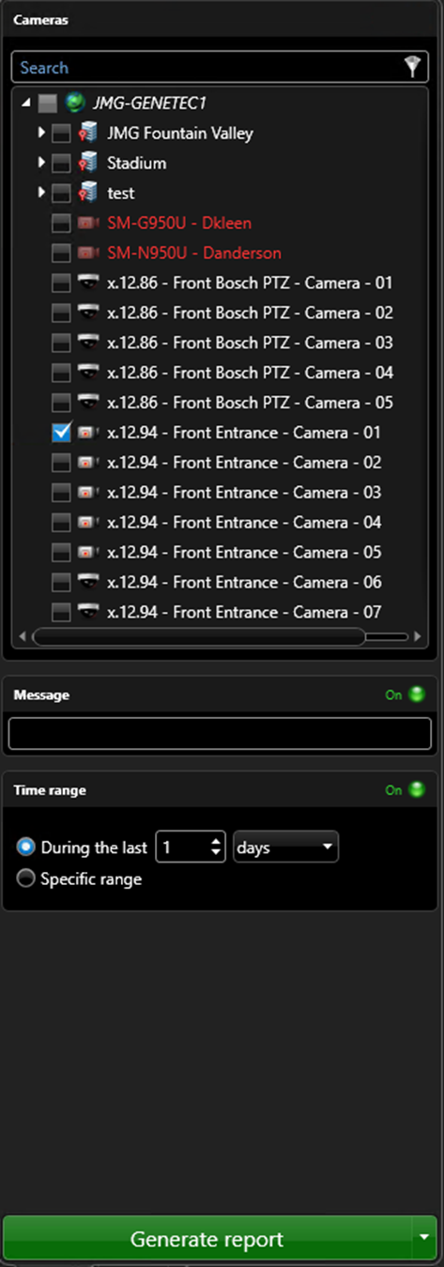
How do I search past video for bookmarks?
  From the Bookmarks task, select search parameters such as camera(s), message and time range.
  Click on the green button at the bottom labeled “Generate report”.
July 2019 / 5.7 version / 17

Slide 18
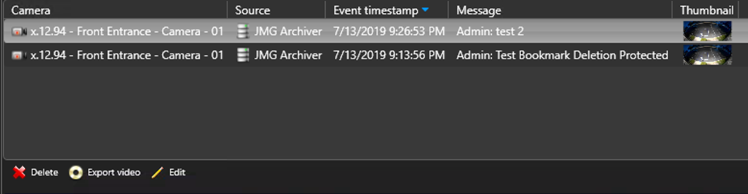
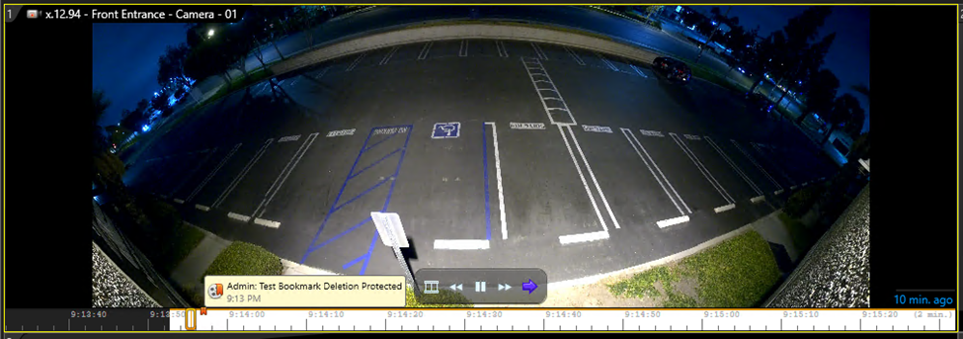
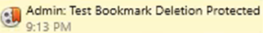
How do I search past video for bookmarks?
  From the report results pane above the canvas, select the Bookmark you would like to view.
  Drag the line item into one of the tiles for viewing.
  The bookmark is notated in the timeline at the bottom of the video.
  You can also delete, export or edit any of the bookmarks by clicking on the icons in the bottom left of the report results pane.
July 2019 / 5.7 version / 18

Slide 19
Additional Resources
For additional resources on how to get the most out of your security system, please visit our website at:
www.jmgsecurity.com
Additional PowerPoint training guides are available from JMG on topics such as overview of Security Desk, viewing live video and searching recorded video. To request any of these, please contact JMG at 800-900-4564.
July 2019 / 5.7 version / 19

