Slide 1

Brivo Onair Access Control End-User Training
User Management
Presented by:

Slide 2
Table of Contents
Brivo Onair Access Control End-User Training
User Management
What is a “user”? What are “groups”? Slide 3
How do I create a new user? Slides 4 - 11
How do I view/edit/delete a user? Slides 12 - 15
Additional Resources Slide 16
Sept 2019 / 11.46 / 2

Slide 3
What is a “user”? What are “groups”?
A “user” is any person who requires access to one or more doors/floors at your workplace.
  A “user” has unique credentials (access card, PIN or Brivo Onair Pass) that enable entry at restricted doors.
  A “user” can belong to one or more groups depending on your hardware restrictions.
A “group” is a set of users with the same access privileges.
  Access privileges are defined at the group level.
USERS
GROUPS/ACCESS RIGHTS
User 1
Executive/Management
Human Resources
User 2
Janitorial
Sept 2019 / 11.46 / 3

Slide 4
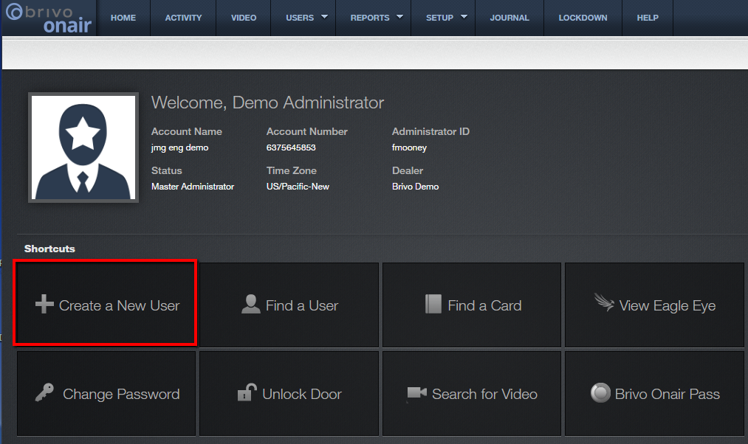
How do I create a new user?
From the Brivo Onair home page, choose the “Create a New User” option from the list of Shortcuts.
JMG Client XYZ
1234567
jsmith
Sept 2019 / 11.46 / 4

Slide 5
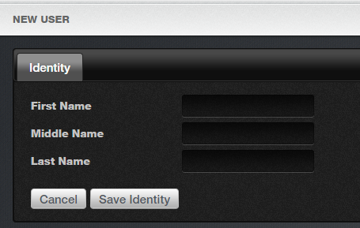
How do I create a new user?
Enter the new user’s name and then click “Save Identity”.
Sept 2019 / 11.46 / 5

Slide 6
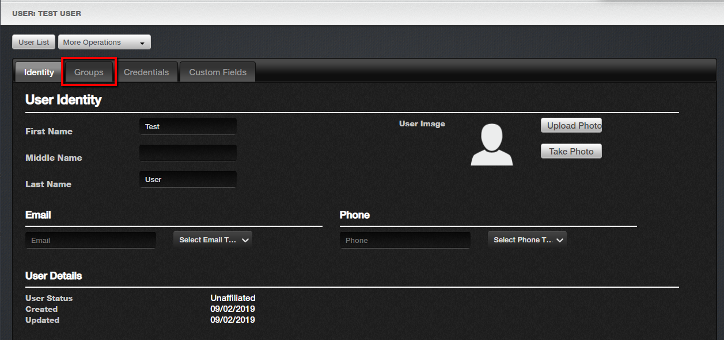
How do I create a new user?
Next, enter any additional information required by your organization such as phone number, email address and/or a photo and then click the tab labeled “Groups”.
Sept 2019 / 11.46 / 6

Slide 7
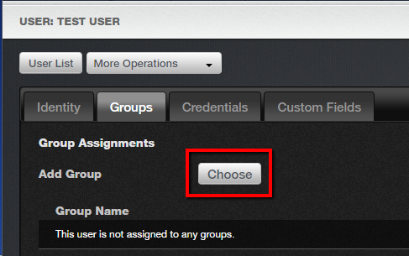
How do I create a new user?
This next screen will allow you to assign a group/access rights to this new user. Click on the “Choose” button located next to the prompt “Add Group”.
Sept 2019 / 11.46 / 7

Slide 8
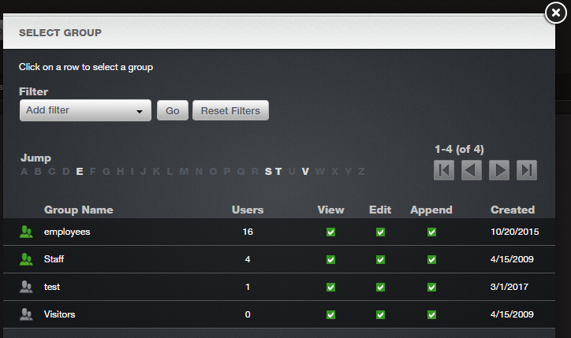
How do I create a new user?
The popup window will display all currently existing groups. Click on the group you would like to assign to the new user. Remember this user will inherit all access rights associated with the selected group(s).
Sept 2019 / 11.46 / 8

Slide 9
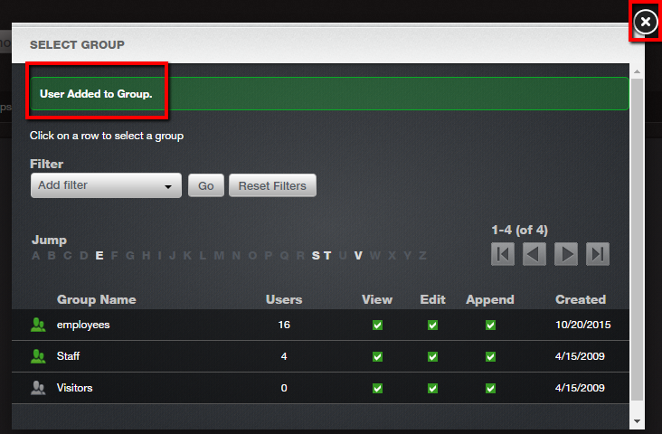
How do I create a new user?
Confirmation will appear in the form of text in a green bar at the top. Continue with this process until all desired groups have been selected. To close this window, click on the X located in the upper right corner.
Sept 2019 / 11.46 / 9

Slide 10
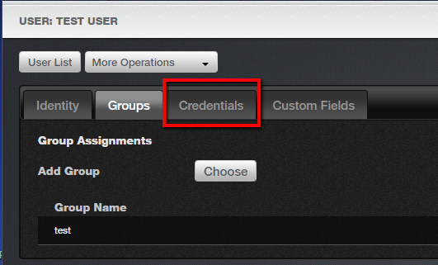
How do I create a new user?
The final step in creating a new user involves assigning a credential which is a unique identifier for that user. Click on the “Credentials” tab to assign a credential to your new user.
Sept 2019 / 11.46 / 10

Slide 11
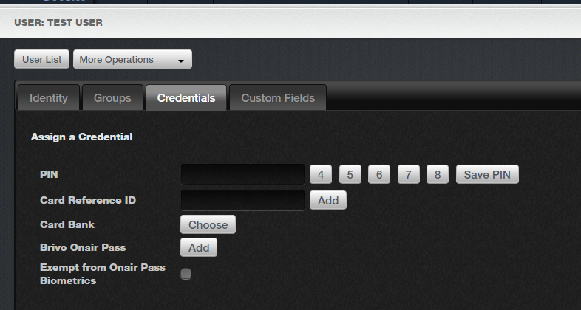
How do I create a new user?
The most common credentials among our clients are access card/key FOB and Brivo Onair Pass.
To assign a card or key FOB from the pool of previously loaded access cards/FOBs, click here.
To assign a Brivo Onair Pass, click here.
Sept 2019 / 11.46 / 11

Slide 12
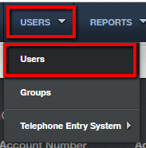
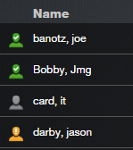

How do I view/edit/delete a user?
From the Brivo Onair home page, click on the Users tab and then select “Users” from the drop down menu.
Smith, Bob
An alphabetized list of all users will appear. Click on the user you would like to view / edit / delete.
Doe, Jane
Jones, Mary
Note that the colored icon next to each user name represents the current user status as explained in the key above.
Williams, Mike
Sept 2019 / 11.46 / 12

Slide 13
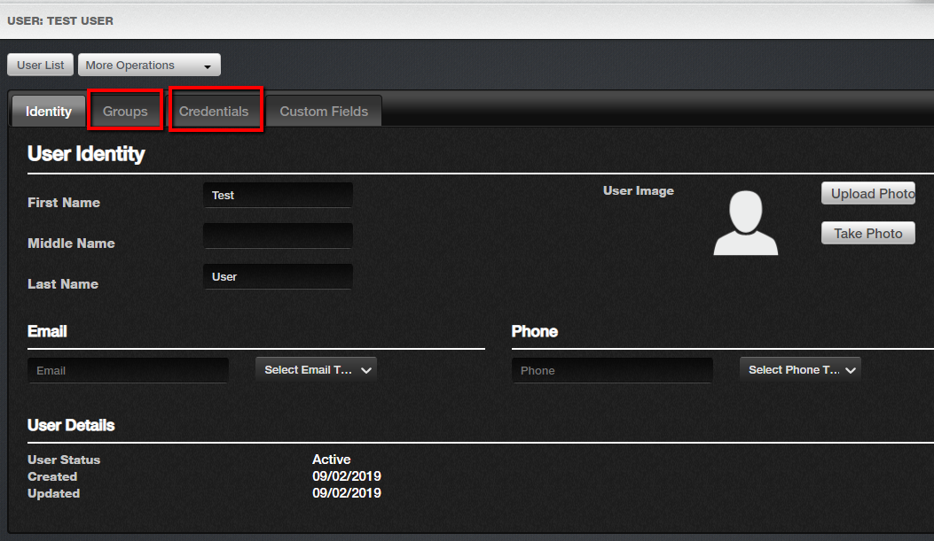
How do I view/edit/delete a user?
From the user detail screen, you can edit any of the information associated with this user including which group(s) and credential(s) are assigned to him/her.
Sept 2019 / 11.46 / 13

Slide 14
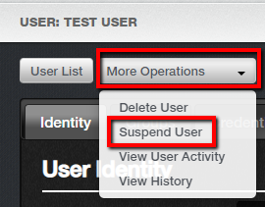
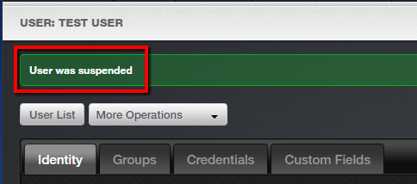
How do I view/edit/delete a user?
To remove a user, we recommend you “Suspend” rather than “Delete” the user. Once a user is deleted, the user cannot be undeleted and his/her credentials cannot be monitored for unsuccessful access attempts.
To suspend a user, click on the “More Operations” button in the top left corner of the user detail screen. And select “Suspend User” from the drop down menu.
The user suspension will be confirmed by a green bar across the top of the screen.
Sept 2019 / 11.46 / 14

Slide 15
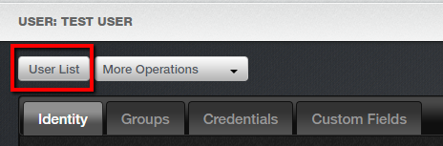
How do I view/edit/delete a user?
To return to your user list, simply click on the “User List” button located in the upper left corner of the user detail screen.
Sept 2019 / 11.46 / 15

Slide 16
Additional Resources
For additional information and resources, please visit our website at:
www.jmgsecurity.com
Additional PowerPoint training guides are available from JMG on other Brivo Onair topics. To request any of these, please contact JMG at 800-900-4564.
Sept 2019 / 11.46 / 16

