Slide 1

Brivo Onair Access Control End-User Training
Reports
Presented by:

Slide 2
Table of Contents
Brivo Onair Access Control End-User Training
Reports
What types of reports are available? Slide 3
What is the Account Summary Report? Slide 4
What is the Account Activity Report? Slide 5
What is the All Users Report? Slide 6
What is the Holiday Report? Slide 7
What is the Schedule Relationship Report? Slide 8
What is the User Activity Report? Slide 9
How do I generate the most common Reports? Slides 10 – 21
How do I create Report Shortcuts? Slides 22 - 24
Additional Resources Slide 25
Sept 2019 / 11.46 / 2

Slide 3
What type of reports are available?
Brivo Onair offers a wide variety of powerful reports that allow you to easily monitor users, doors/devices, activity, holidays/schedules and more.
We will offer a brief explanation of the most common reports and provide an overview of the report generation process. The most common reports are:
  Account Activity Report
  Account Summary Report
  All Users Report
  Holiday Report
  Schedule Relationship Report
  User Activity Report
For an in-depth look at all reporting features, please visit the Brivo Onair Administrator’s Manual available in the Help section of the Brivo website.
Sept 2019 / 11.46 / 3

Slide 4
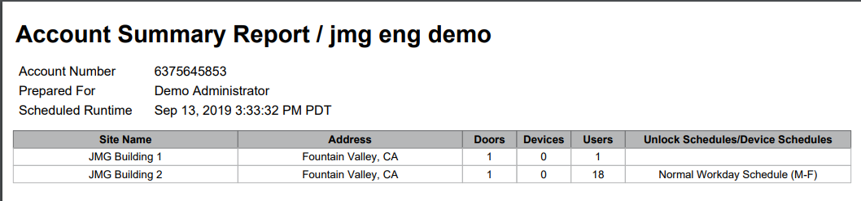
What is the Account Summary Report?
The Account Summary Report provides an alphabetized list of all sites with summarized information for the last 24 hours such as:
  Site Name
  Site City Name and State
  Quantity of Doors
  Quantity of Devices
  Quantity of Users
  Name of Unlock Schedules
JMG Client XYZ
1234567
Sept 2019 / 11.46 / 4

Slide 5
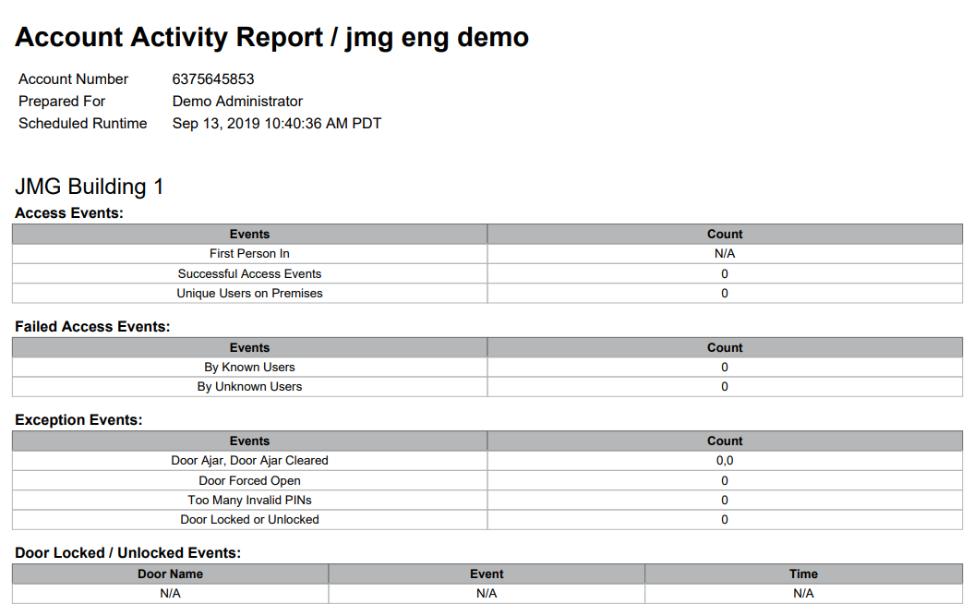
What is the Account Activity Report?
The Account Activity Report provides an overview of all sites with information for each site such as:
JMG Client XYZ
Access Events
Failed Access Events
Exception Events
Doors Locked/Unlocked Events
Programmable Device Events
Wiring Events
Control Panel and Board Events
1234567
Sept 2019 / 11.46 / 5

Slide 6
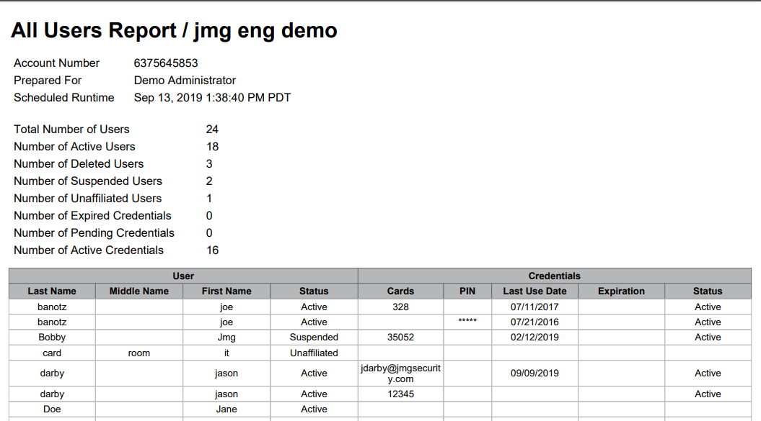
What is the All Users Report?
The All Users Report provides an alphabetized list of all users (within a designated 90-day window) and all corresponding information for each user such as:
    Last name
    First Name
    Card/PIN credential
    Status
    Expiration Date
    Last Credential Use Date
JMG Client XYZ
1234567
Adams John Active 1234 9/12/2019 Active
Brown Molly Active 5987 9/12/2019 Active
Jones Sally Suspended 6842 8/10/2019 Suspended
Sept 2019 / 11.46 / 6

Slide 7
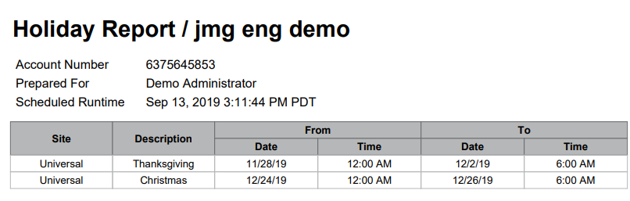
What is the Holiday Report?
The Holiday Report will list all holidays in the account sorted by date and includes information such as:
  Site
  Holiday Description
  Start and End Dates
JMG Client XYZ
1234567
Sept 2019 / 11.46 / 7

Slide 8
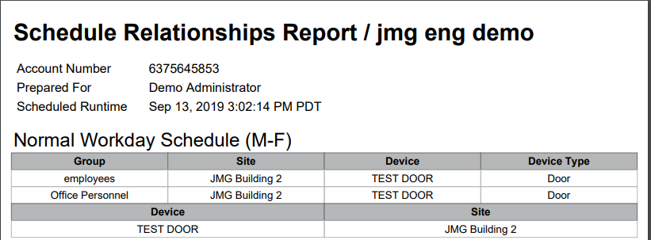
What is the Schedule Relationship Report?
The Schedule Relationship Report allows you to select an existing schedule and view all User Groups and Devices that are connected to the selected schedule.
JMG Client XYZ
1234567
Sept 2019 / 11.46 / 8

Slide 9
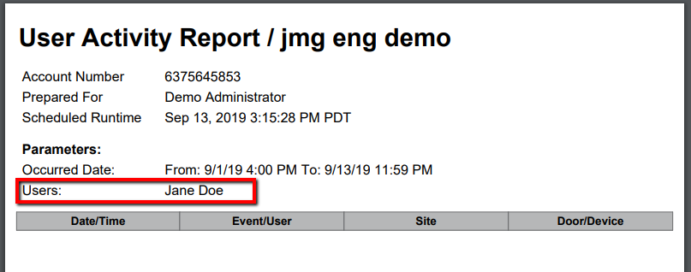
What is the User Activity Report?
The User Activity Report allows you to select an existing user or an existing User Group and provides a summary of all activity for that user or group for a given time period.
JMG Client XYZ
1234567
Sept 2019 / 11.46 / 9

Slide 10
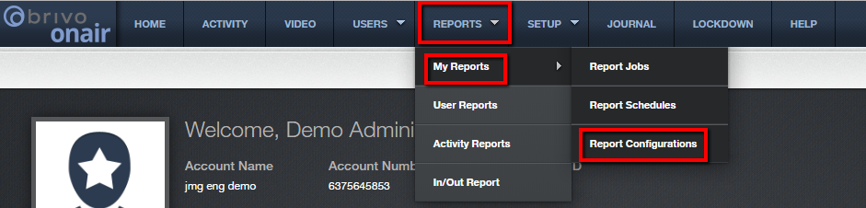
How do I generate the most common reports?
Report Configuration: from the Brivo Onair home page, navigate to the Reports tab at the top of the screen and then navigate to My Reports and then click on Report Configurations.
JMG Client XYZ
1234567
Once a report has been configured for the first time, the configuration for that report is saved and this step can be skipped in the future.
Sept 2019 / 11.46 / 10

Slide 11
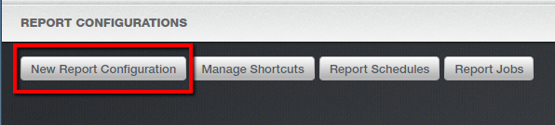
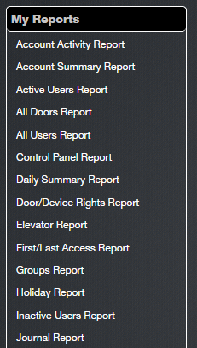
How do I generate the most common reports?
Click on the “New Report Configuration” button in the upper left corner of the screen.
From the list provided, select which report to configure.
Sept 2019 / 11.46 / 11

Slide 12
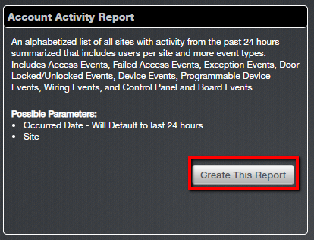
How do I generate the most common reports?
A brief description of the report selected will appear in the box to the right. Confirm the selection and click “Create This Report”.
Sept 2019 / 11.46 / 12

Slide 13
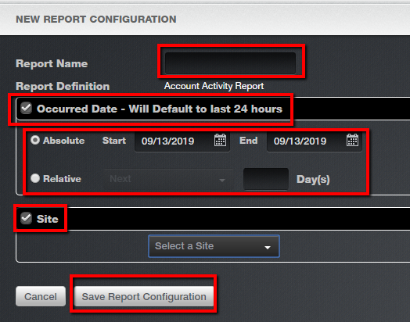
How do I generate the most common reports?
For our example, we have chosen the Account Activity Report. For this report, you will be asked to assign a Report Name, designate a time frame or use the default of last 24 hours and select a site from the drop down menu. If Occurred Date box is left unchecked, the default of last 24 hours will be used.
Please note that the specific report fields will differ based on the report selected.
And then click on “Save Report Configuration” at the bottom of the screen.
Sept 2019 / 11.46 / 13

Slide 14
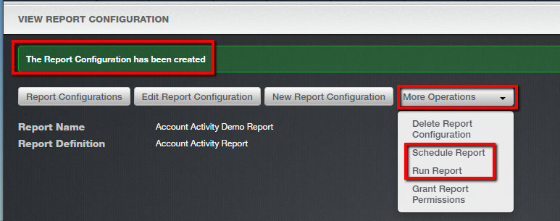
How do I generate the most common reports?
Confirmation that your new report configuration was created and saved appears at the top of the next screen.
To run the report immediately, choose “More Operations” and “Run Report”.
To run the schedule the report to run in the future, select “More Operations” and “Schedule Report”.
Sept 2019 / 11.46 / 14

Slide 15
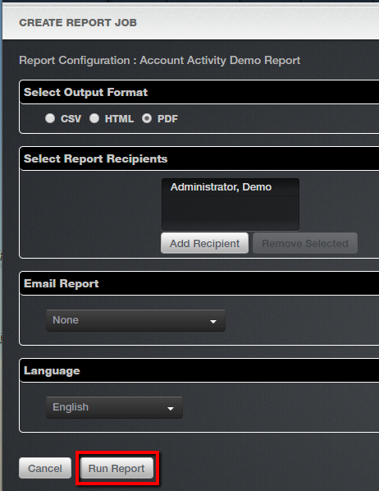
How do I generate the most common reports?
7a. If you choose to run report immediately, you will be taken to the Create Report Job screen.
Here, you will be asked to designate the desired output format, select report recipients from the list of Brivo Onair users, instruct Brivo to also email the report and choose the preferred language.
After you have made all your selections, click “ Run Report”.
Sept 2019 / 11.46 / 15

Slide 16
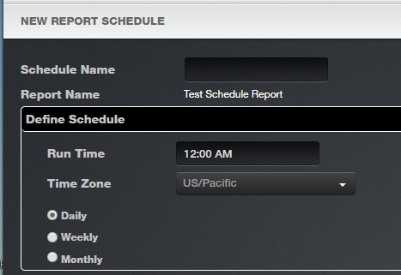
How do I generate the most common reports?
7b. If you choose to schedule your report instead of run it immediately the steps are nearly identical with two exceptions. You will be asked to name the schedule and to determine the schedule for running the report.
Sept 2019 / 11.46 / 16

Slide 17
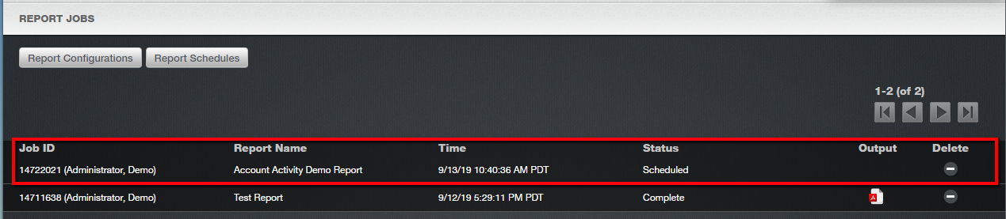
How do I generate the most common reports?
8a. If you chose to run the report immediately, you will be taken to the Reports Jobs page which shows your job in the Reports Queue with a status of “Scheduled”.
Sept 2019 / 11.46 / 17

Slide 18
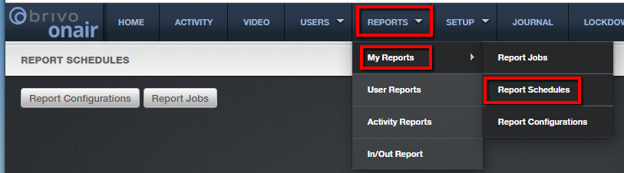
How do I generate the most common reports?
8b. If you chose to schedule the report, you can confirm/edit the schedule and view all scheduled reports by navigating to the Reports tab and then selecting My Reports and then Report Schedules.
Sept 2019 / 11.46 / 18

Slide 19
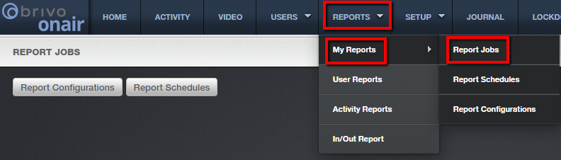
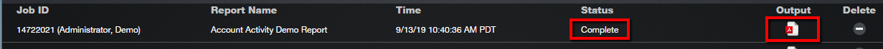
How do I generate the most common reports?
To view report results (scheduled and immediate), you’ll need to refresh the Reports queue. To do this navigate to the Reports tab, choose My Reports and choose Report Jobs.
When the report status reflects “Complete”, you will see an icon available under the “Output” column. Click on the icon to view and/or download the report.
Sept 2019 / 11.46 / 19

Slide 20

How do I generate the most common reports?
The creation of a report configuration is a one-time process. Once a report is configured, you may run the report very easily and quickly by navigating to Reports, then selecting My Reports and Report Configurations.
JMG Client XYZ
1234567
Sept 2019 / 11.46 / 20

Slide 21
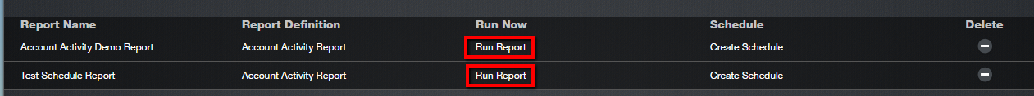
How do I generate the most common reports?
A list of all report configurations will appear. Simply click on the “Run Report” option next to the report you would like to run.
Sept 2019 / 11.46 / 21

Slide 22
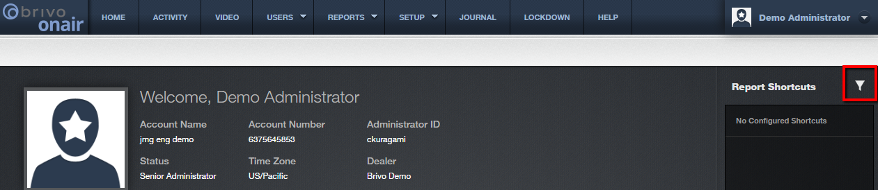
How do I create Report Shortcuts?
You can create shortcuts for your most commonly-used reports by following these steps.
From the home page, select on the “funnel” icon in the Reports Shortcuts section of the home page.
JMG Client XYZ
1234567
jsmith
Sept 2019 / 11.46 / 22

Slide 23
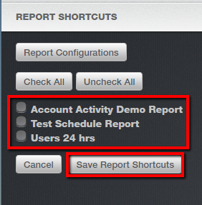
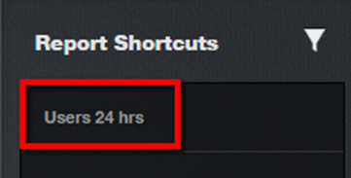
How do I create Report Shortcuts?
The Reports Shortcuts screen will display all current reports. Check the box next to the report for which you would like to create a shortcut.
Click on the “Save Report Shortcuts” button.
You can confirm by navigating back to the Home page where you will see the report displayed under Report Shortcuts.
Sept 2019 / 11.46 / 23

Slide 24
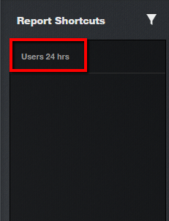
How do I create Report Shortcuts?
You can create shortcuts for your most commonly used reports by following these steps.
The Reports Shortcuts screen will display all current report. Check the box next to the report for which you would like to create a shortcut.
Click on the “Save Report Shortcuts” button.
Sept 2019 / 11.46 / 24

Slide 25
Additional Resources
For additional information and resources, please visit our website at:
www.jmgsecurity.com
Additional PowerPoint training guides are available from JMG on other Brivo Onair topics. To request any of these, please contact JMG at 800-900-4564.
Sept 2019 / 11.46 / 25

