Slide 1

Brivo Onair Access Control End-User Training
Brivo Onair Pass
Presented by:

Slide 2
Table of Contents
Brivo Onair Access Control End-User Training
Brivo Onair Pass
What is Brivo Onair Pass? Slide 3
How do I enable Brivo Onair Pass Functionality? Slides 4 - 8
How do I assign a Brivo Onair Pass to a User? Slides 9 - 14
How does a User use Brivo Onair Pass? Slides 15 – 17
How do I revoke a User’s Brivo Onair Pass? Slide 18
Additional Resources Slide 19
Sept 2019 / 11.46 / 2

Slide 3
What is Brivo Onair Pass?
Brivo Onair Pass is a downloadable application that can provide users with the ability to access secured areas with a smartphone.
Brivo Onair Passes beyond the first five are available for purchase. Please contact JMG if you would like to purchase passes for your users.
Brivo Onair Pass is available for installation on iOS devices through the Apple Store and on Android devices through the Google Play Store.
Brivo OnAir firmware version 5.0.12 or higher is required.
Supported devices for iOS:
  iPhone 4s or higher (requires iOS 8.2 or higher)
  iPod Touch 5th generation (requires iOS 8.2 or higher)
  iPad (requires iOS 8.2 or higher)
Supported devices for Android:
  Android devices running Google Android 4.0.3 or higher
Mobile device must be connected to the Internet either via Wi-Fi or cellular.
Sept 2019 / 11.46 / 3

Slide 4
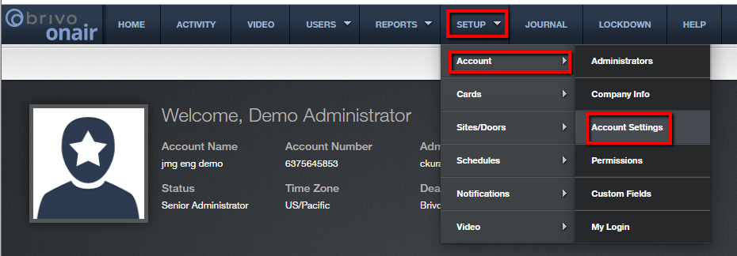
How do I enable Brivo Onair Pass functionality?
To confirm Brivo Onair Pass functionality has been enabled at the account level, follow these steps:
From the home page, navigate to the Setup tab, then select Account and then Account Settings.
JMG Client XYZ
1234567
jsmi
Sept 2019 / 11.46 / 4

Slide 5
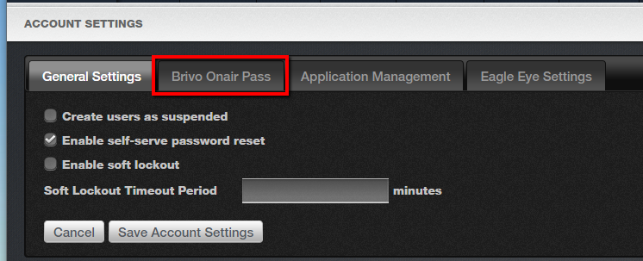
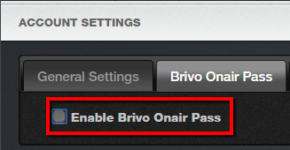
How do I enable Brivo Onair Pass functionality?
Then select the “Brivo Onair Pass” tab at the top of the screen.
Check the box to enable Brivo Onair Pass.
Sept 2019 / 11.46 / 5

Slide 6
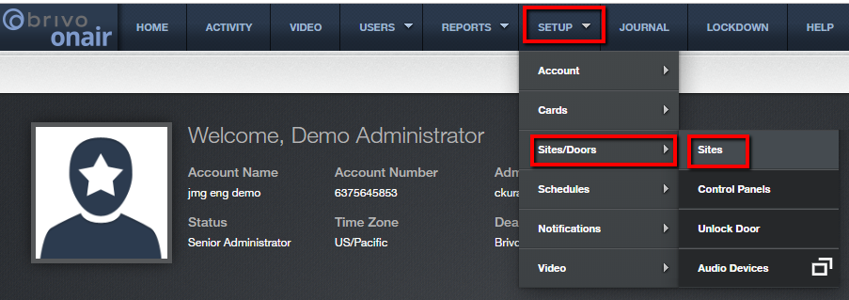
How do I enable Brivo Onair Pass functionality?
For each door you would like to be able to accept Brivo Onair passes, follow these steps:
From the home page, navigate to the Setup tab, then select Sites/Doors and then Sites.
JMG Client XYZ
1234567
jsmi
Sept 2019 / 11.46 / 6

Slide 7

How do I enable Brivo Onair Pass functionality?
Click on the desired site name.
Next, click on the desired door name.
Sept 2019 / 11.46 / 7

Slide 8
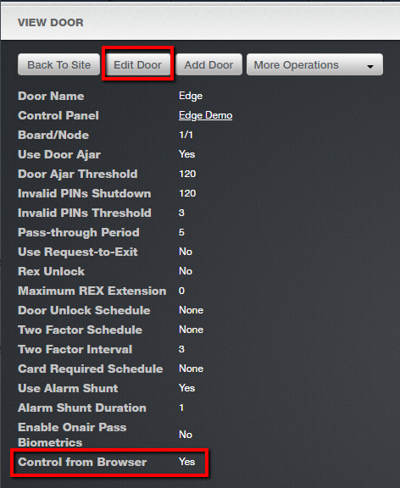
How do I enable Brivo Onair Pass functionality?
Ensure that at the bottom of the screen, Control from Browser reads “Yes”. If not, click on the “Edit Door” button at the top of the screen to change the field from “No” to “Yes”.
Sept 2019 / 11.46 / 8

Slide 9
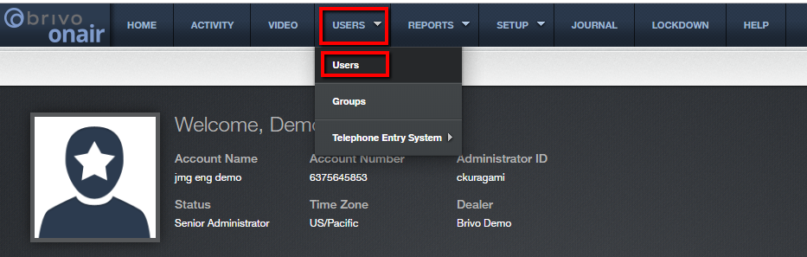
How do I assign a Brivo Onair Pass to a User?
Assigning a Brivo Onair Pass to a user is similar to assigning any other credential. See steps below:
From the home page, navigate to the Users tab, then select Users.
JMG Client XYZ
1234567
jsmith
Sept 2019 / 11.46 / 9

Slide 10
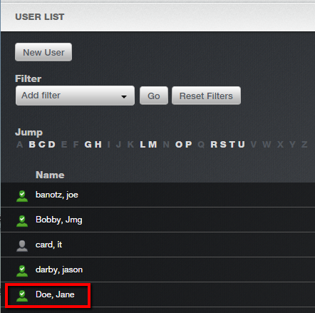
How do I assign a Brivo Onair Pass to a User?
From the User List, select the desired User.
Adams, Bob
Brown, Mary
Chase, Mark
Dell, John
Sept 2019 / 11.46 / 10

Slide 11
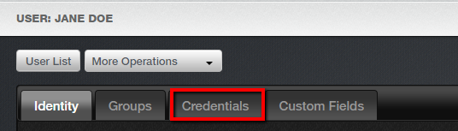
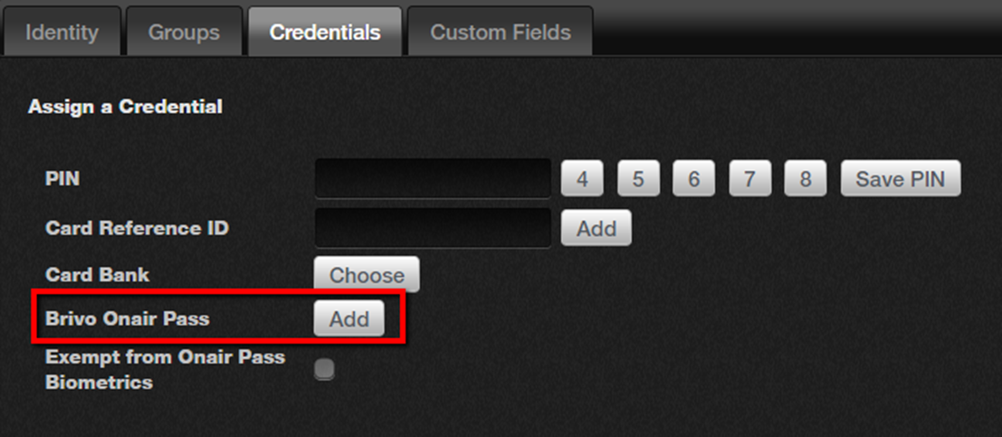
How do I assign a Brivo Onair Pass to a User?
From the User Detail screen, select the “Credentials” tab.
Click on the “Add” button for Brivo Onair Pass.
Sept 2019 / 11.46 / 11

Slide 12
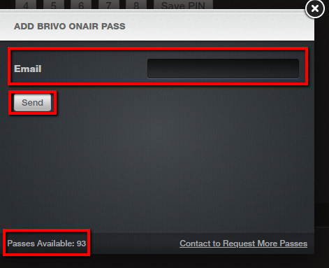
How do I assign a Brivo Onair Pass to a User?
Confirm you have passes available by checking the number in the lower left corner of the screen. Assuming there are passes available, add recipient’s email address and click “Send” to send the credential to the user.
Sept 2019 / 11.46 / 12

Slide 13
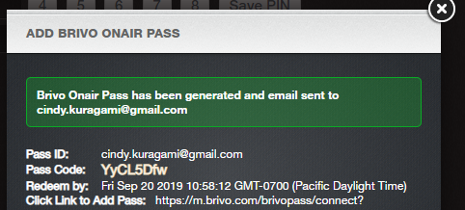
How do I assign a Brivo Onair Pass to a User?
A confirmation will appear in the next box along with the user’s unique pass code and expiration.
Jdoe@xyz.com
Jdoe@xyz.com
Sept 2019 / 11.46 / 13

Slide 14
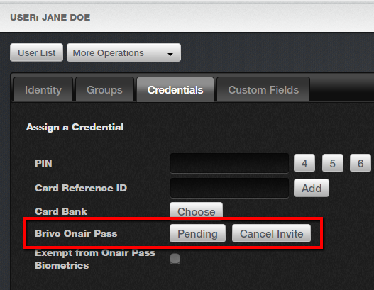
How do I assign a Brivo Onair Pass to a User?
After you’ve sent the invitation on the User Detail screen, you will see the Brivo Onair Pass reflect as “Pending”. Should you want to cancel the invitation, simply click on the “Cancel Invite” button.
Sept 2019 / 11.46 / 14

Slide 15
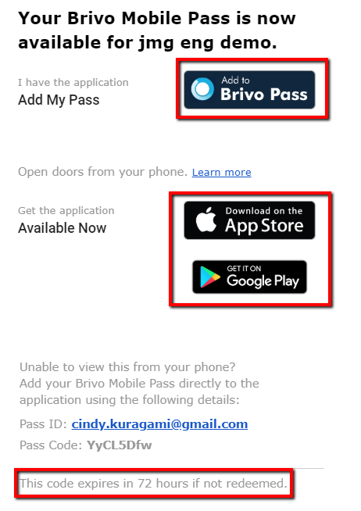
How does a User use Brivo Onair Pass?
To the right is an example of the email invitation that the recipient will receive from brivomobilepass@brivo.com.
The user should open the email from his/her smartphone. If the user already has the Brivo Pass application, the user can add the Pass directly to the application.
If the user does not already have the application, he/she can download the app from the Apple App Store or Google Play Store.
Note that the invitation will expire in 72 hours if not redeemed.
Jdoe@xyz.com
Sept 2019 / 11.46 / 15

Slide 16
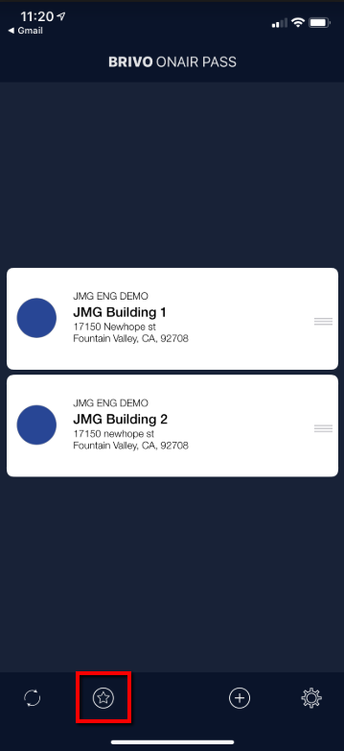
How does a User use Brivo Onair Pass?
From the app home screen, the user will be able to select a site and then select the specific door he/she would like to access.
Alternatively, the user may designate specific doors as favorites which allows the user quick access via the Favorites view.
Sept 2019 / 11.46 / 16

Slide 17
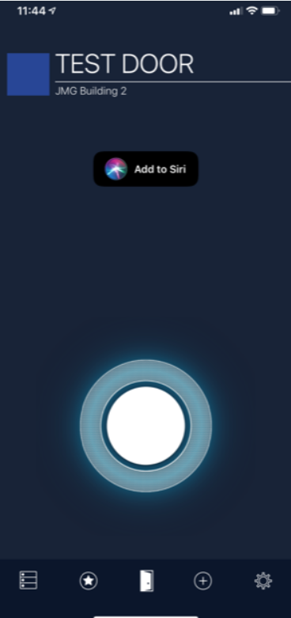
How does a User use Brivo Onair Pass?
Once a door has been selected, the user can access the door by holding down the circular button at the bottom of the screen. This button will light up green upon successful access.
Sept 2019 / 11.46 / 17

Slide 18
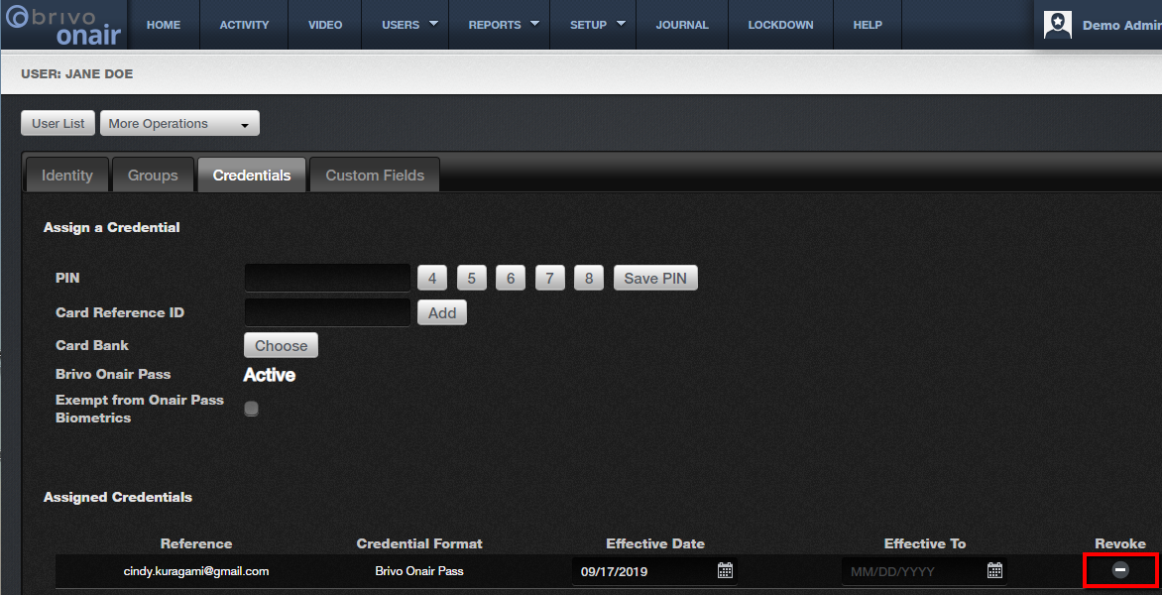
How do I revoke a User’s Brivo Onair Pass?
To revoke a user’s Brivo Onair Pass: navigate to the Credentials tab of the User’s detail screen. Then, next to the Brivo Onair Pass credential, click on the icon below the Revoke column.
Jdoe@xyz.com
Sept 2019 / 11.46 / 18

Slide 19
Additional Resources
For additional information and resources, please visit our website at:
www.jmgsecurity.com
Additional PowerPoint training guides are available from JMG on other Brivo Onair topics. To request any of these, please contact JMG at 800-900-4564.
Sept 2019 / 11.46 / 19

