Slide 1

Brivo Onair Access Control End-User Training
General Overview
Presented by:

Slide 2
Table of Contents
Brivo Onair Access Control End-User Training
General Overview
What is Brivo Onair? Slide 3
How do I access Brivo Onair? Slide 4
How do I navigate the Brivo OnairHome Page? Slides 5 - 7
How do I log off? Slide 8
Additional Resources Slide 9
Sept 2019 / 11.42 / 2

Slide 3
What is Brivo Onair?
Brivo Onair is a web-based software application that allows you to manage your organization’s access control system.
Your access control system is the physical security system which selectively restricts physical access to various areas within your workplace.
While your version of Brivo Onair may vary slightly from the screenshots you are about to see, please note that your version should look and function very similarly.
Sept 2019 / 11.42 / 3

Slide 4
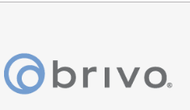

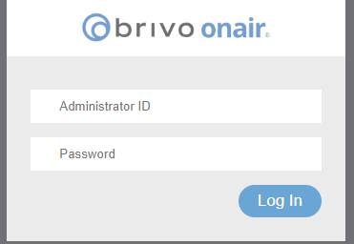
How do I access Brivo Onair?
Because Brivo Onair is a web-based platform, you can access it using any computer that is connected to the Internet.
Simply type into your browser the following URL address: www.brivo.com
Then select “Login” from the upper right corner
Enter your JMG-provided username and password and then click “Log In”
Sept 2019 / 11.42 / 4

Slide 5
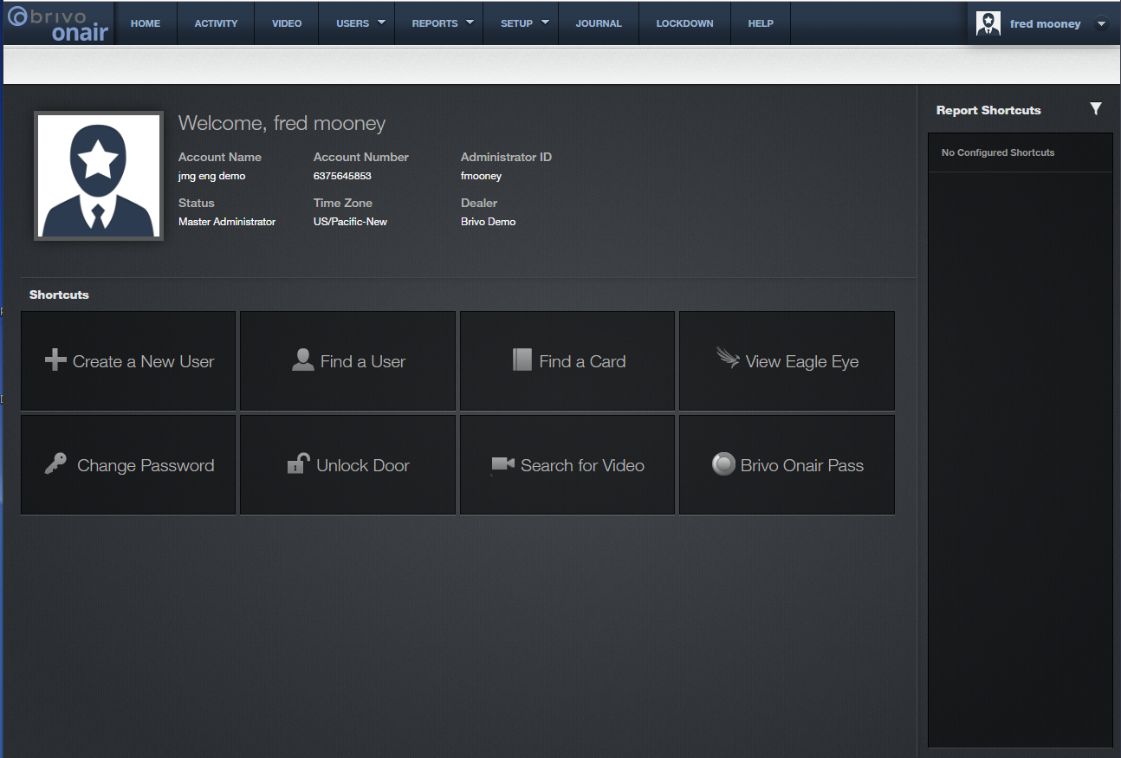
How do I navigate the Brivo Onair Home Page?
At the top of the home page you will see various tabs across the top of the screen. An arrow next to the tab title indicates a drop down menu is available.
Home = returns you to the home page
Activity = provides a list of events such as successful/unsuccessful access of doors
Video = allows you to view video if your security cameras are connected to Brivo Onair
Users = allows you to view and manage individual users and groups of users
Reports = houses all reports such as User Reports, Activity Reports, etc.
Setup = contains all setup information for your access control system such as administrators, door schedules, notifications, cards, etc.
Journal = provides quick access to a log of Administrator activities
Lockdown = enables you to override regular access privileges in an emergency situation
Help = contains support documentation
Sept 2019 / 11.42 / 5

Slide 6
How do I navigate the Brivo Onair Home Page?
Welcome, Jane Smith
JMG Client XYZ
1234567
jsmith
Just below the row of tabs, you will see your Brivo Onair account information summarized.
Account Name
Account Number
Administrator ID
Administrator Status
Time Zone
Dealer
Sept 2019 / 11.42 / 6

Slide 7
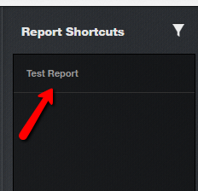
How do I navigate the Brivo Onair Home Page?
In the middle of the home page, you will see shortcuts to the most common administrative tasks.
Create a New User
Find a User
Find a Card
View Eagle Eye (cameras)
Change Password
Unlock Door
Search for Video
Brivo Onair Pass
And on the right side of the home page, you will see shortcuts to your reports.
Sept 2019 / 11.42 / 7

Slide 8
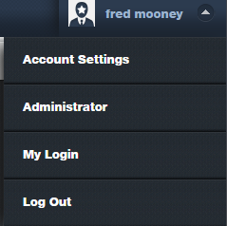
How do I log off?
Jane Smith
To log off, from any screen within Brivo Onair, simply click on the arrow next to your name in the upper right corner of the screen which will cause a drop down menu to appear.
Jane Smith
Select “Log Out” to securely log out of Brivo Onair.
Sept 2019 / 11.42 / 8

Slide 9
Additional Resources
For additional resources on how to get the most out of your security system, please visit our website at:
www.jmgsecurity.com
Additional PowerPoint training guides are available from JMG on topics such as viewing live video, searching recorded video and exporting video. To request any of these, please contact JMG at 800-900-4564.
Sept 2019 / 11.42 / 9

