Slide 1

Brivo Onair Access Control End-User Training
Group Management
Presented by:

Slide 2
Table of Contents
Brivo Onair Access Control End-User Training
Group Management
What is a “user”? What are “groups”? Slide 3
How do I create a new group? Slides 4 - 10
How do I add a user to a group? Slides 11 - 14
How do I delete a user from a group? Slides 15 – 16
How do I edit/delete a group? Slides 17 - 18
Additional Resources Slide 19
Sept 2019 / 11.46 / 2

Slide 3
What is a “user”? What are “groups”?
A “user” is any person who requires access to one or more doors/floors at your workplace.
  A “user” has unique credentials (access card, PIN or Brivo Onair Pass) that enable entry at restricted doors.
  A “user” can belong to one or more groups depending on your hardware restrictions.
A “group” is a set of users with the same access privileges.
  Access privileges are defined at the group level.
USERS
GROUPS/ACCESS RIGHTS
User 1
Executive/Management
Human Resources
User 2
Janitorial
Sept 2019 / 11.46 / 3

Slide 4
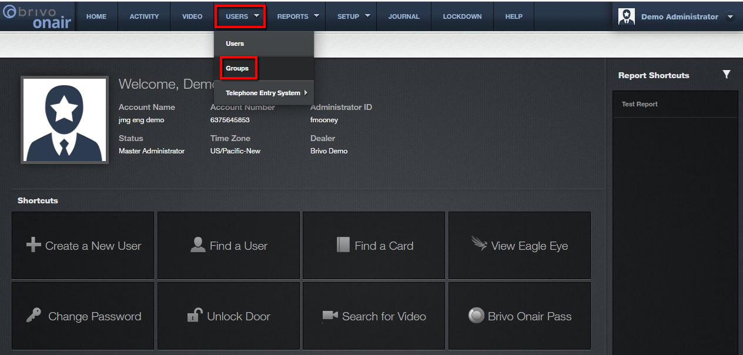
How do I create a new group?
From the Brivo Onair home page, click on the Users tab at the top of the screen and then select Groups.
JMG Client XYZ
1234567
jsmith
Sept 2019 / 11.46 / 4

Slide 5
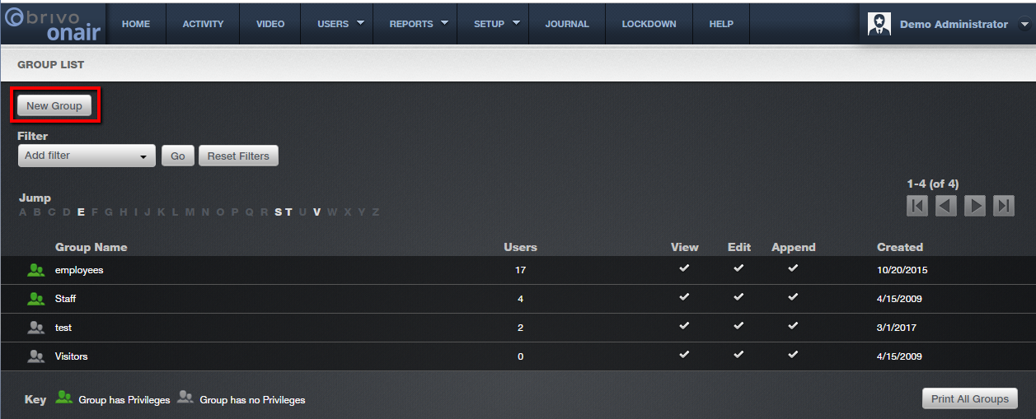
How do I create a new group?
The next screen displays all currently existing groups. From the top of the screen select “New Group”.
Sept 2019 / 11.46 / 5

Slide 6
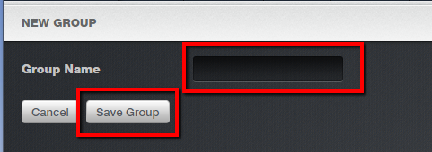
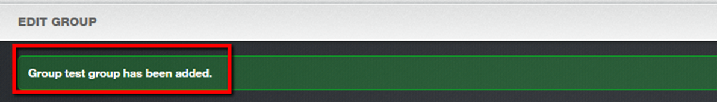
How do I create a new group?
Next, enter a brief descriptive Group Name in the box provided, such as “Janitorial Staff”. Then click “Save Group”.
The next screen is the Edit Group screen which will confirm the Group was added by providing white text in a green bar across the top of the screen.
Sept 2019 / 11.46 / 6

Slide 7
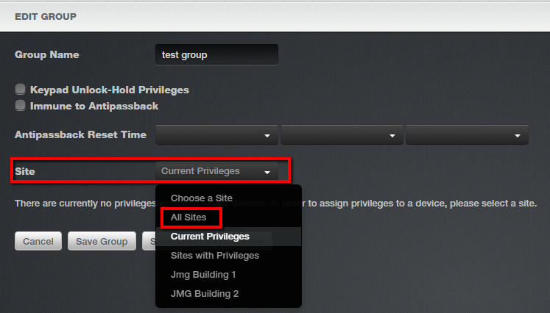
How do I create a new group?
On the Edit Group screen you will need to determine privilege parameters for the new group.
Valid only for doors with keypads: When checked, this allows any member of this group to override a door unlock schedule by presenting his/her credentials and entering “99#” at the door keypad.
When checked, all members of this group will not be impacted by any antipassback settings. For more details on antipassback settings, please visit the Brivo Onair User Guide in the Help section of the website.
Next choose “All Sites” from the Site drop down menu. This will allow you to specify which site(s) this group will be able to access.
Sept 2019 / 11.46 / 7

Slide 8
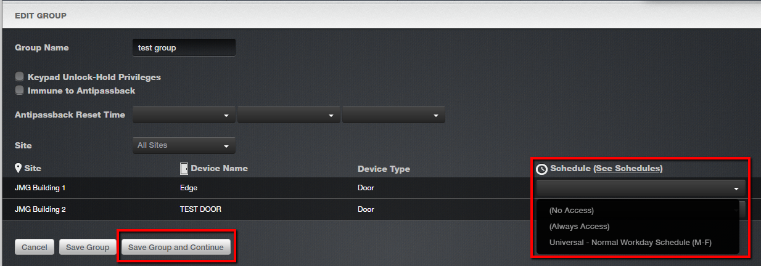
How do I create a new group?
The list of available site(s) will be displayed along with all the devices/doors associated with each site. Select which device/door(s) you would like this new group to access, by selecting a schedule in the drop down box for each desired device/door.
Sept 2019 / 11.46 / 8

Slide 9
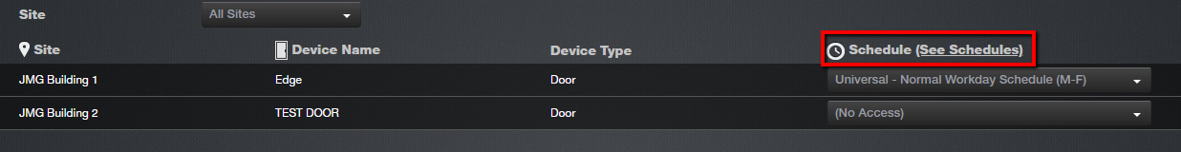
How do I create a new group?
To view the details of each schedule, please click on the “See Schedules” link located above the Schedule drop down boxes.
Please note: the schedules that are displayed here refer to all previously created schedules. To learn how to create a new schedule please review JMG’s tutorial on Door Schedule Management.
Sept 2019 / 11.46 / 9

Slide 10
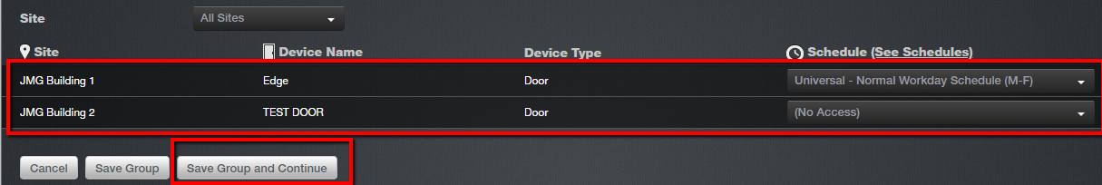
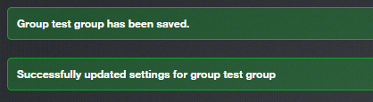
How do I create a new group?
In the example below, I have designated this new group to have access to the door called “Edge” within the JMG Building 1 for the hours designated in the schedule titled “Normal Workday Schedule (M-F)”. However, this new group will not have access to the door called “TEST DOOR” in JMG Building 2.
Make sure to click “Save Group and Continue” at the bottom of the screen. And you will see white text in a green box confirming the changes have been saved.
Sept 2019 / 11.46 / 10

Slide 11
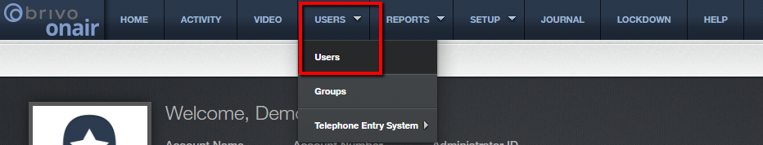
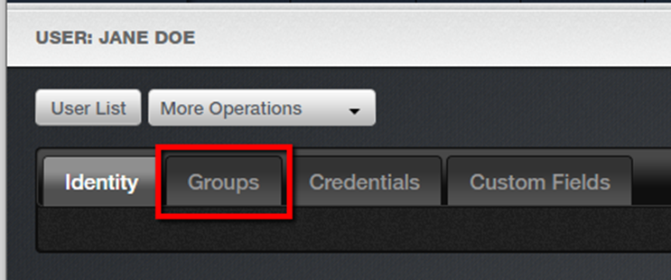
How do I add a user to a group?
To add a user to a group, navigate to the User Detail screen by clicking on the Users tab and selecting Users from the drop down list.
Click on the desired user from the list displayed.
From the User Detail screen, select the Groups tab.
Sept 2019 / 11.46 / 11

Slide 12
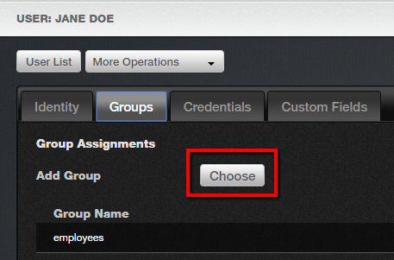
How do I add a user to a group?
Click on the “Choose” button to assign a group to this user.
Please note: the maximum number of groups that a user can have is sixteen (16).
Sept 2019 / 11.46 / 12

Slide 13
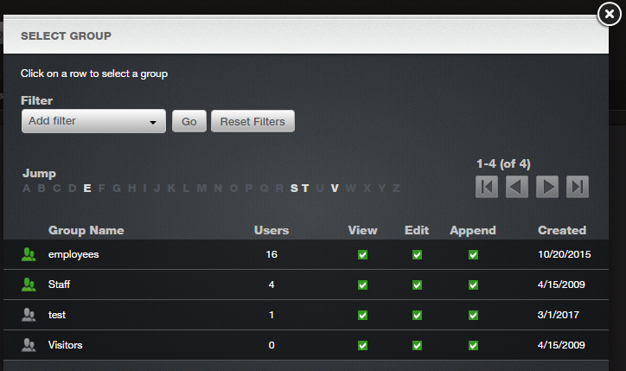
How do I add a user to a group?
The next popup window will display all currently existing groups. Click on the group you would like to assign to this user. Remember this user will inherit all access rights associated with the selected group(s).
Sept 2019 / 11.46 / 13

Slide 14
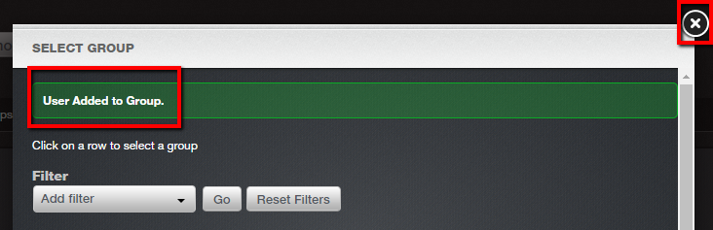
How do I add a user to a group?
Confirmation will appear in the form of text in a green bar at the top. Continue with this process until all desired groups have been selected. To close this window, click on the X located in the upper right corner.
Sept 2019 / 11.46 / 14

Slide 15

How do I delete a user from a group?
To delete a user from a group, navigate to the Group List screen by clicking on the Users tab and selecting Groups from the drop down list.
Click on the desired group.
Sept 2019 / 11.46 / 15

Slide 16
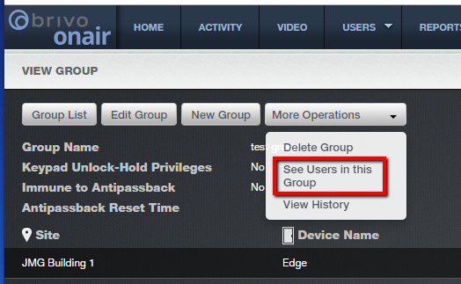
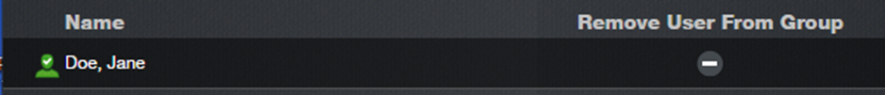
How do I delete a user from a group?
Click on “More Operations” and select “See Users in this Group” in the drop down list.
Select “Remove User From Group” next to the user’s name.
Sept 2019 / 11.46 / 16

Slide 17
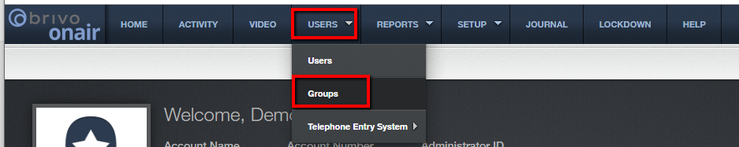
How do I edit/delete a group?
To make changes or delete a group, click on the Users tab and choosing Groups in the drop down list.
Click on the desired group from the list displayed.
Sept 2019 / 11.46 / 17

Slide 18
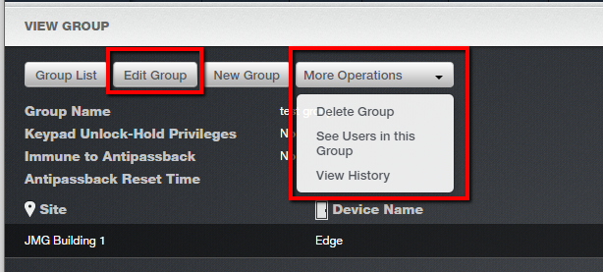
How do I edit/delete a group?
From the View Group screen, you can “Edit Group”, “Delete Group”, “See Users”.
Sept 2019 / 11.46 / 18

Slide 19
Additional Resources
For additional information and resources, please visit our website at:
www.jmgsecurity.com
Additional PowerPoint training guides are available from JMG on other Brivo Onair topics. To request any of these, please contact JMG at 800-900-4564.
Sept 2019 / 11.46 / 19

