Slide 1

Brivo Onair Access Control End-User Training
Door Schedule Management
Presented by:

Slide 2
Table of Contents
Brivo Onair Access Control End-User Training
Door Schedule Management
What is a “door”, “device” and “site”? Slide 3
What is a “schedule”? Slide 4
What is a “holiday”? Slide 5
How do I create a new schedule? Slides 6 - 9
How do I create a new holiday? Slides 10 – 14
How do I momentarily unlock a door? Slides 15 – 16
What is the lockdown feature? Slides 17 - 20
Additional Resources Slide 21
Sept 2019 / 11.46 / 2

Slide 3
What is a “door”, “device” and “site”?
A “door” is any exterior or interior door with an electronic means of entry, such as a keypad or card reader.
A “device” is anything that can be an input to the access control system such as an IT Server Room Temp Sensor. The fact that a device is an input to the system means the access control system has the ability to monitor that device and trigger an output based on predetermined instructions.
A “site” is a logical group of doors, devices and floors.
  An account can have one or more sites associated with it.
  See example below:
Site: JMG Building 1
Door: Lobby Exterior
Door: CEO Office
Door: IT Server Room
Device: Server Room Temp Sensor
Sept 2019 / 11.46 / 3

Slide 4
What is a “schedule”?
A “schedule” is an editable and reusable time template that controls when a door is accessible or when a device is activated.
A group of users is permitted access to a door according to a predefined schedule.
  A user’s access privileges are the result of a three-way relationship between the following:
    Door
    User Group
    Schedule
Schedule:
“Workday”
User Group: All Employees
Door: Lobby Interior
User Group: Cleaning Crew
Schedule:
“Night Shift”
Sept 2019 / 11.46 / 4

Slide 5
What is a “holiday”?
A “holiday” is a designated period of time during which access privileges are either denied or follow a special schedule.
  For example, a holiday period titled “Winter Break” might be applied to the “Lobby Door” between December 25 and December 27. During this holiday period, access will be based on a special Holiday schedule that overrides its usual schedule.
Sept 2019 / 11.46 / 5

Slide 6
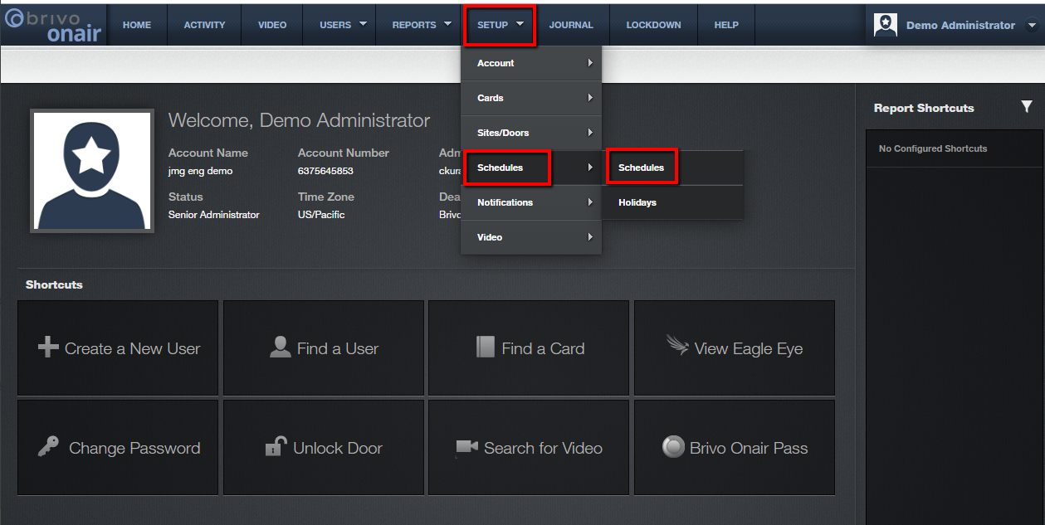
How do I create a new schedule?
From the Brivo Onair home page, click on the Setup tab at the top of the screen and then select Schedules and then Schedules.
JMG Client XYZ
1234567
js
Sept 2019 / 11.46 / 6

Slide 7
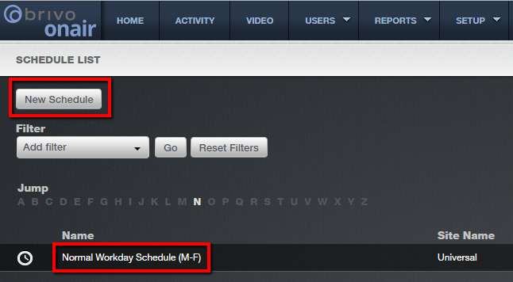
How do I create a new schedule?
All previously created schedules will appear on this next screen.
To create a new schedule, click on the “New Schedule” button in the upper left corner of the screen.
To view any of the existing schedules simply click on the schedule name.
Sept 2019 / 11.46 / 7

Slide 8
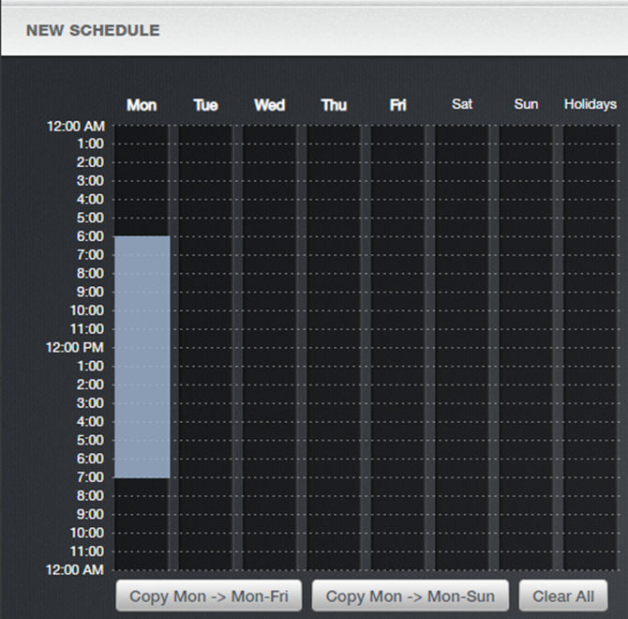
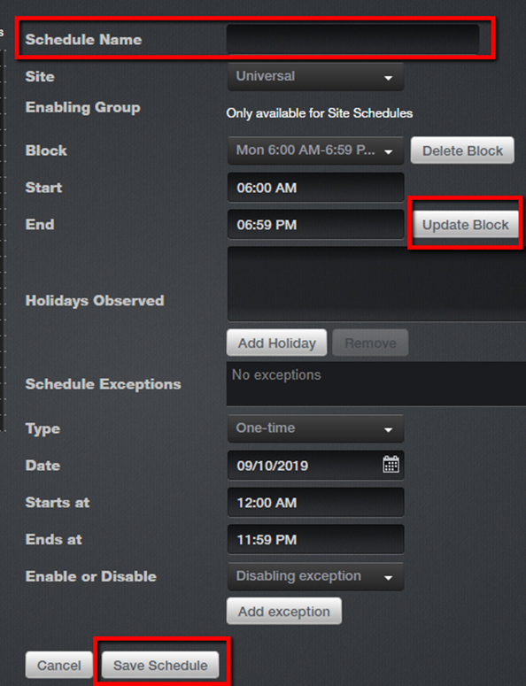
How do I create a new schedule?
Complete the fields such as Name, Site and times as described below:
You can make this schedule available to all sites (Universal) or available to specific sites/groups. Please read the Brivo Onair Admin manual to fully understand the risks associated with group enabled schedules before making this selection.
In the schedule grid, use your mouse to drag your cursor across the hours during which users should have access to associated doors. And you can fine tune the hours and minutes in the fields labeled “Start” and “End”. Make sure to click “Update Block” to save any adjustments.
Sept 2019 / 11.46 / 8

Slide 9
How do I create a new schedule?
Complete the fields such Holidays and Exceptions as described below:
To observe a holiday, click on the “Add Holiday” button and then use your mouse cursor within the Holidays column to establish which hours during the holiday period you want to allow access. If the Holidays column is left blank, no access will be permitted during that period.
The remaining fields apply to schedule exceptions. For more information on schedule exceptions please visit the Brivo Onair Admin Manual located in the Help section of the website.
Click “Save Schedule” to complete the schedule creation process.
Sept 2019 / 11.46 / 9

Slide 10
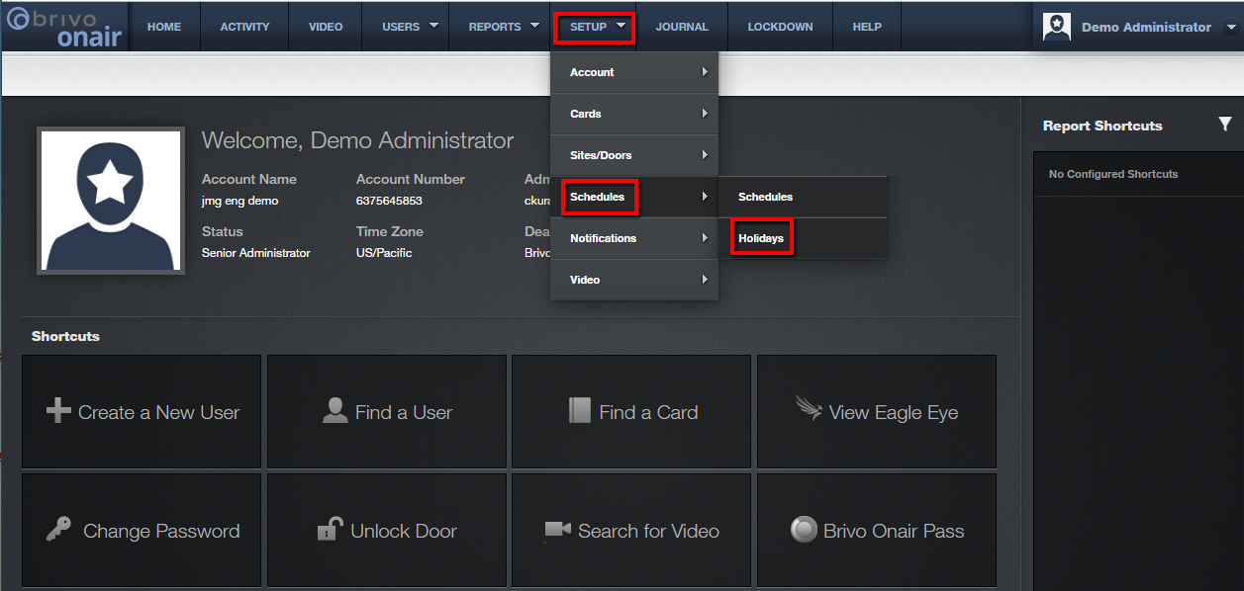
How do I create a new holiday?
From the Brivo Onair home page, click on the Setup tab at the top of the screen and then select Schedules and then Holidays.
JMG Client XYZ
1234567
js
Sept 2019 / 11.46 / 10

Slide 11
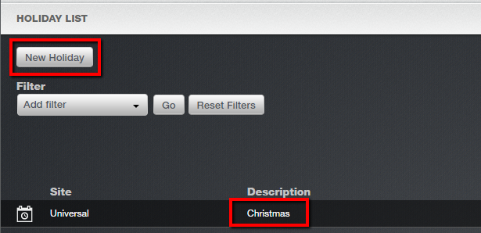
How do I create a new holiday?
All previously created holidays will appear on this next screen.
To create a new holiday, click on the “New Holiday” button in the upper left corner of the screen.
To view any of the existing holidays simply click on the corresponding description.
Sept 2019 / 11.46 / 11

Slide 12
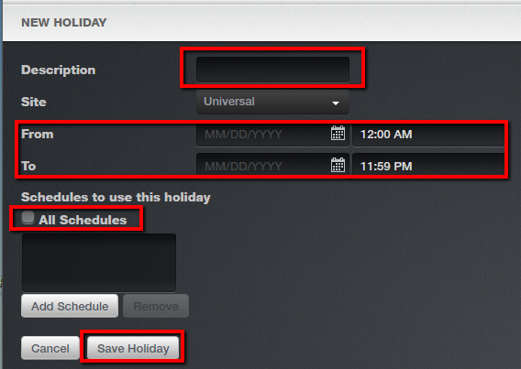
How do I create a new holiday?
The most common method for creating a new holiday is completing the necessary fields as follows:
Enter a brief descriptive name for this holiday (such as “Christmas”)
Designate a start day and time as well as an end day and time.
If this holiday applies to all schedules then check the box labeled “All Schedules”.
Make sure to click “Save Holiday” to complete the holiday creation process.
Sept 2019 / 11.46 / 12

Slide 13
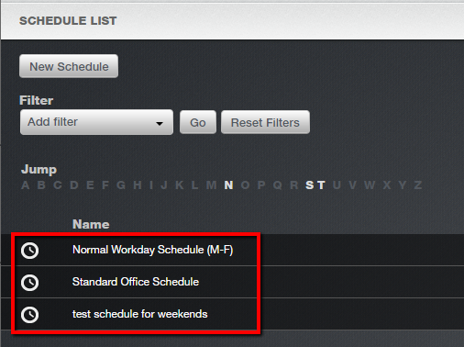
How do I create a new holiday?
Now that the Christmas holiday has been created, all schedules in effect during the Christmas holiday period will refer to their respective Holiday override columns in the schedule time grid or if that column is blank then access will be suspended for the duration of the holiday. We will provide a specific example to show you what that means.
Navigate to a specific Schedule by selecting “Setup”, then “Schedules” and then “Schedules”.
From the Schedule List (see below), click on one of the schedules displayed.
Sept 2019 / 11.46 / 13

Slide 14
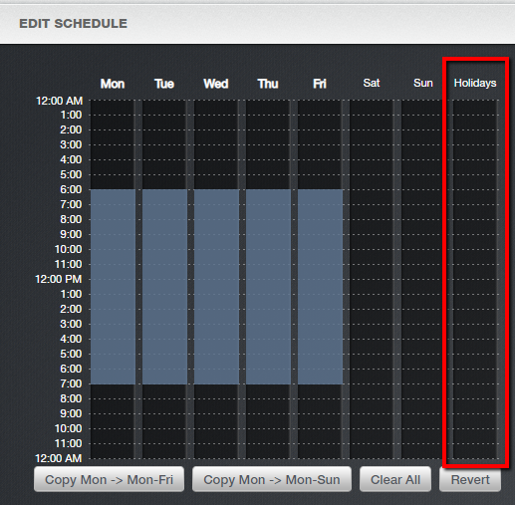
How do I create a new holiday?
If the holiday column is blank as it is in this example, access to all doors using this schedule will be denied during the applied holiday periods.
Should you want to grant access during the holiday period then simply use your mouse to highlight the hours to allow access.
Sept 2019 / 11.46 / 14

Slide 15
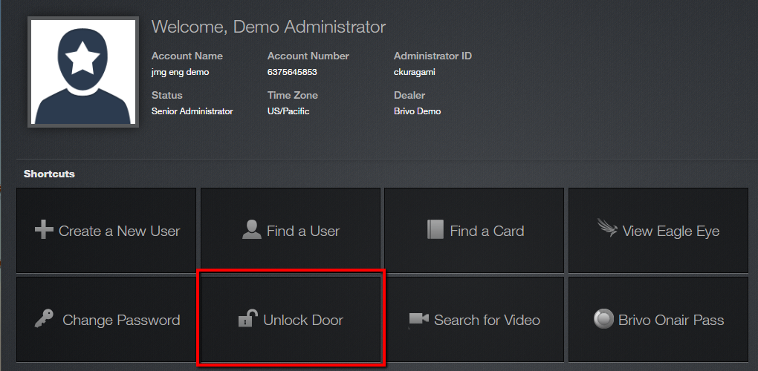
How do I momentarily unlock a door?
From the home page, click on the “Unlock Door” shortcut located in the middle of the screen.
JMG Client XYZ
1234567
jsmith
NOTE: The availability of this unlock feature is based on the firmware of your control panels.
Sept 2019 / 11.46 / 15

Slide 16
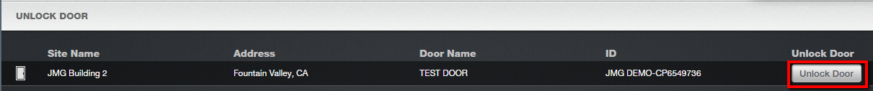
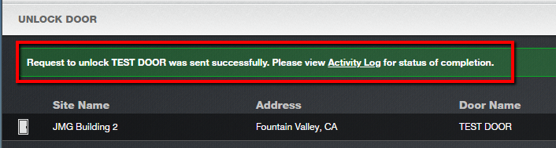
How do I momentarily unlock a door?
A list of available doors will be displayed. To unlock a door, simply click on the “Unlock Door” button corresponding to the desire door.
Confirmation will appear at the top of the screen in the form of white text in a green box.
Sept 2019 / 11.46 / 16

Slide 17
What is the lockdown feature?
The lockdown feature allows an Administrator to quickly revoke access privileges from a large number of users such as in an emergency situation.
When activated, the lockdown feature overrides ALL schedules, holidays and door timers.
When de-activated, all schedules, holidays and effects return to their normal settings.
For detailed information about this feature, please review the Brivo Onair Admin Manual located in the Help section of the Brivo Onair website.
Sept 2019 / 11.46 / 17

Slide 18
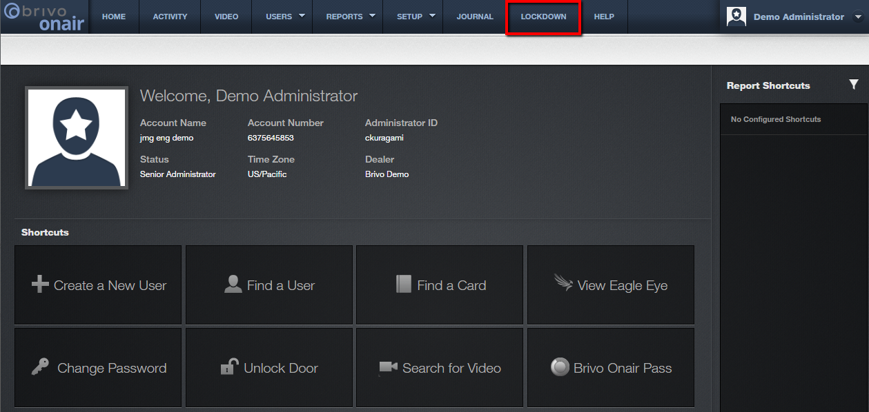
What is the lockdown feature?
To activate the lockdown feature, from the home page, click on the “Lockdown” tab at the top of the screen.
JMG Client XYZ
1234567
jsmith
Sept 2019 / 11.46 / 18

Slide 19
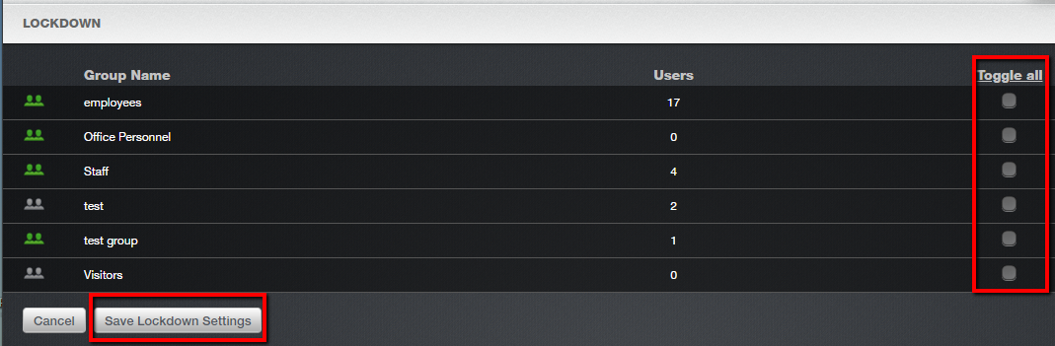
What is the lockdown feature?
Check the box next to the group(s) for which you would like to apply the lockdown. If you would like to apply the lockdown to all groups, click on the “Toggle all” link.
Click on the “Save Lockdown Settings” button. All access privileges associated with the selected groups will be revoked within 5 minutes. No group member will be allowed entry at any secured door.
Sept 2019 / 11.46 / 19

Slide 20
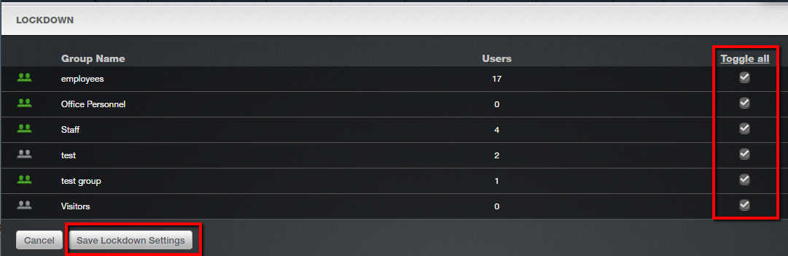
What is the lockdown feature?
To de-activate the lockdown feature, navigate to this same Lockdown screen and unselect all groups.
Click on the “Save Lockdown Settings” button. All access privileges will then be restored.
Sept 2019 / 11.46 / 20

Slide 21
Additional Resources
For additional information and resources, please visit our website at:
www.jmgsecurity.com
Additional PowerPoint training guides are available from JMG on other Brivo Onair topics. To request any of these, please contact JMG at 800-900-4564.
Sept 2019 / 11.46 / 21

